Slide 1

Visualize Data with

Slide 2

(Applied) Data Science
Visualize
Import
Tidy
Model
Communicate
Transform
Program

Slide 3
"The simple graph has brought more information to the data analyst’s mind than any other device. "
- John Tukey

Slide 4
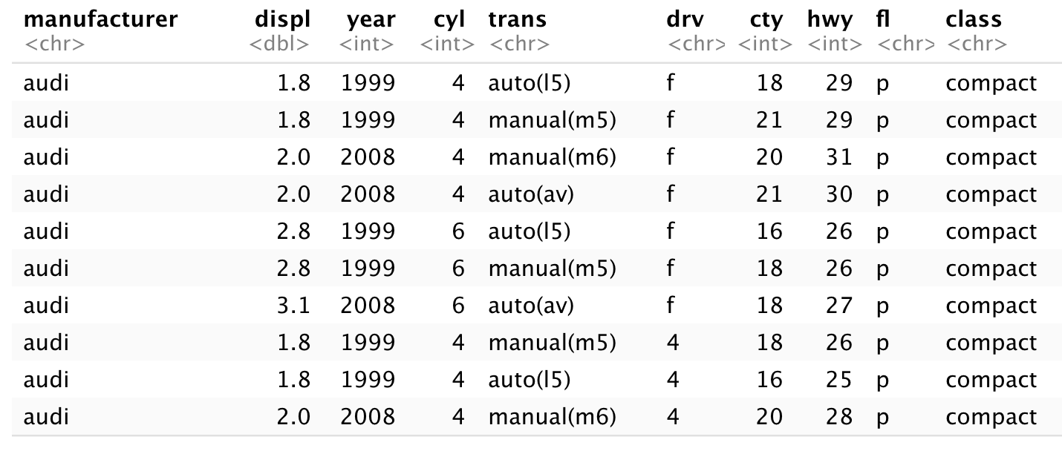
mpg
Fuel economy data for 38 models of car.
mpg

Slide 5

Quiz
Confer with your group.
What relationship do you expect to see between engine size (displ) and mileage (hwy)?
No peeking ahead!

Slide 6

Your Turn 1
Run this code in 02-Visualize-Exercises.Rmd to make a graph. Pay strict attention to spelling, capitalization, and parentheses!
ggplot(data = mpg) +
geom_point(mapping = aes(x = displ, y = hwy))

Slide 7
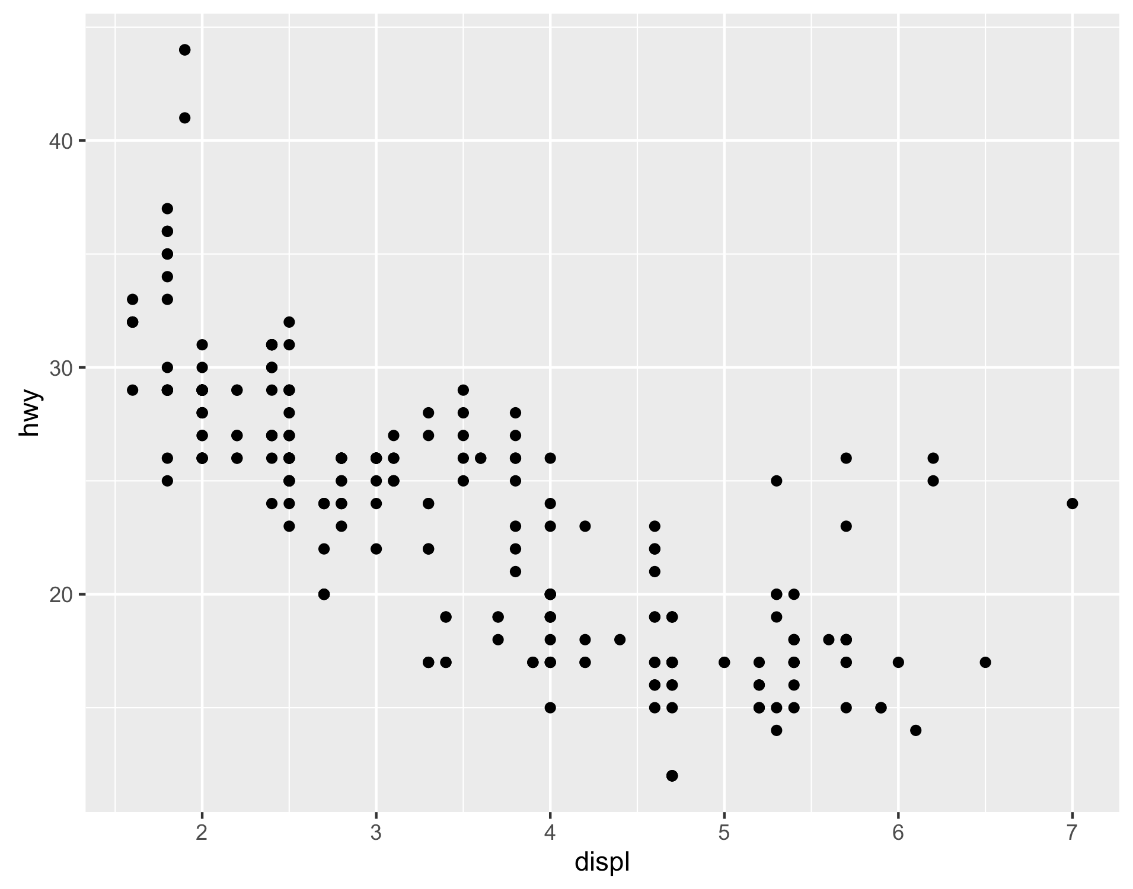
ggplot(data = mpg) +
geom_point(mapping = aes(x = displ, y = hwy))

Slide 8
"Initialize" a plot with ggplot()
Add layers with geom_ functions
ggplot(data = mpg) +
geom_point(mapping = aes(x = displ, y = hwy))

Slide 9
Pro tip: Always put the + at the end of a line, Never at the start
ggplot(data = mpg) +
geom_point(mapping = aes(x = displ, y = hwy))

Slide 10
data
+ before new line
ggplot(data = mpg) +
geom_point(mapping = aes(x = displ, y = hwy))
type of layer
aes()
x variable
y variable

Slide 11
A template
ggplot(data = <DATA>) +
<GEOM_FUNCTION>(mapping = aes(<MAPPINGS>))
ggplot(data = mpg) +
geom_point(mapping = aes(x = displ, y = hwy))

Slide 12
A template
ggplot(data = <DATA>) +
<GEOM_FUNCTION>(mapping = aes(<MAPPINGS>))

Slide 13

Mappings

Slide 14
"The greatest value of a picture is when it forces us to notice what we never expected to see."
- John Tukey

Slide 15
How can we test the theory?
Why do these cars get better mileage?
ggplot(data = mpg) +
geom_point(mapping = aes(x = displ, y = hwy))

Slide 16
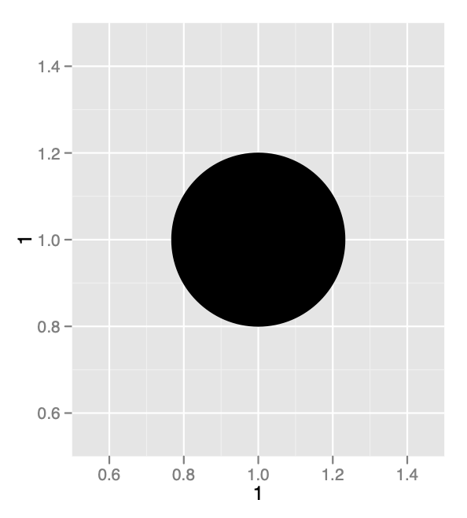
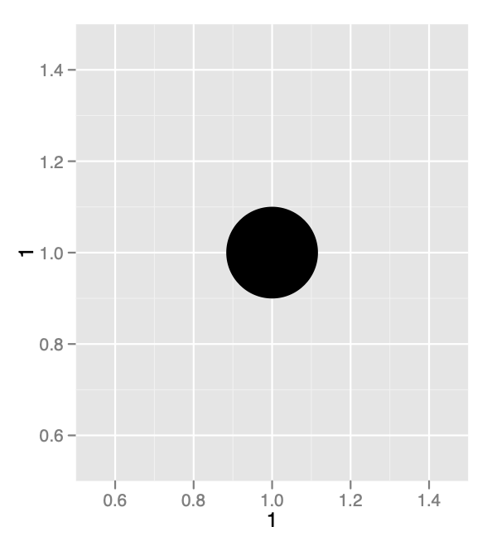
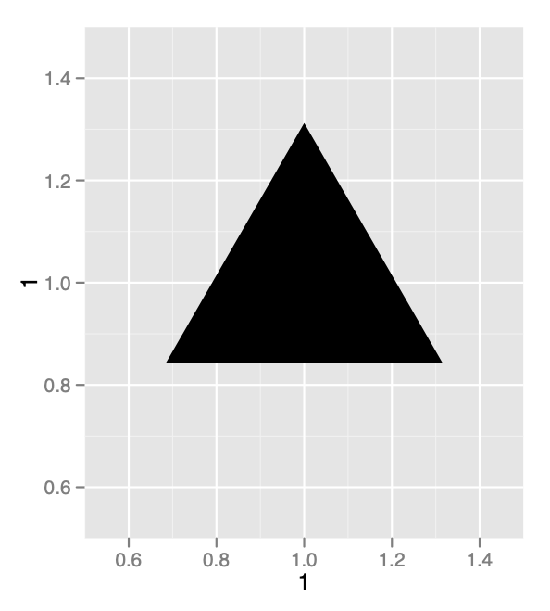
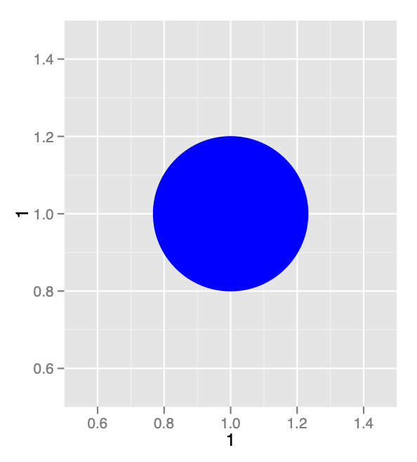
Aesthetics

Slide 17
Visual Space
Data Space
color
class
Red
Brown
Green
Aqua
Blue
Violet
Pink
2seater
compact
midsize
minivan
pickup
subcompact
suv

Slide 18
Aesthetics
aesthetic property
Variable to map it to
ggplot(mpg) + geom_point(aes(x = displ, y = hwy, color = class))
ggplot(mpg) + geom_point(aes(x = displ, y = hwy, size = class))
ggplot(mpg) + geom_point(aes(x = displ, y = hwy, shape = class))
ggplot(mpg) + geom_point(aes(x = displ, y = hwy, alpha = class))

Slide 19

Your Turn 2
In the next chunk, add color, size, alpha, and shape aesthetics to your graph. Experiment.
Do different things happen when you map aesthetics to discrete and continuous variables?
What happens when you use more than one aesthetic?

Slide 20
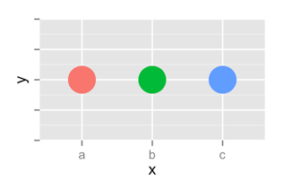
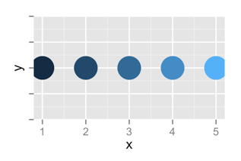
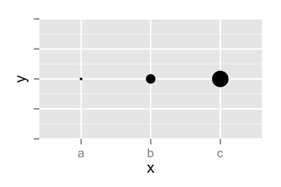
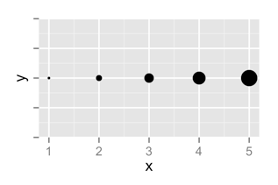
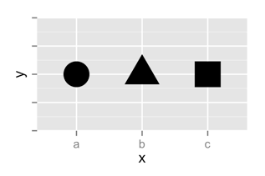
 | Discrete | Continuous
Color
Size
Shape

Slide 21
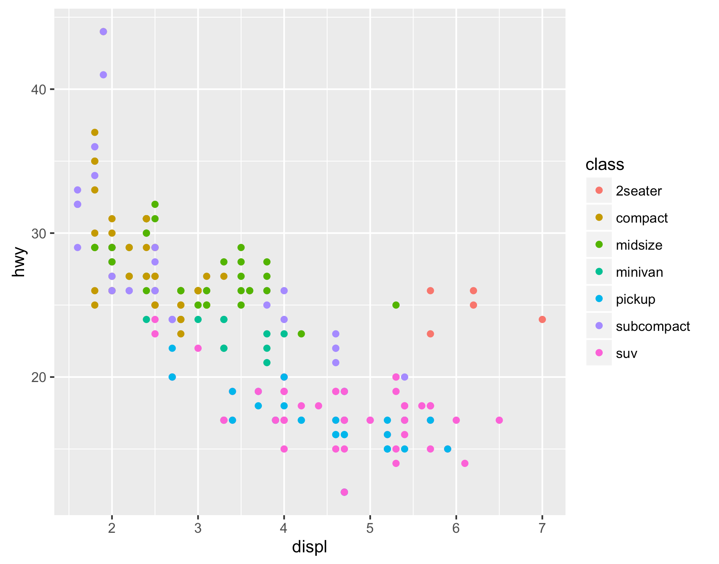
Legend added automatically
ggplot(data = mpg) +
geom_point(mapping = aes(x = displ, y = hwy, color = class))

Slide 22
Error!
ggplot(data = mpg) +
geom_point(mapping = aes(x = displ, y = hwy), color = class)

Slide 23
Facets

Slide 24
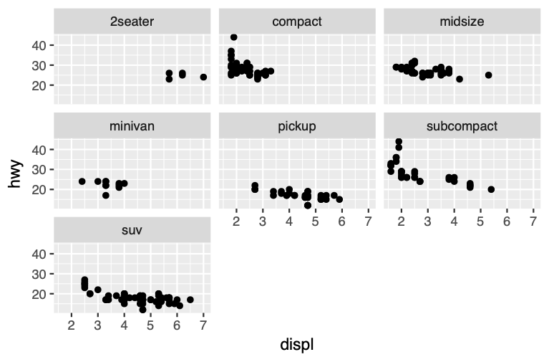
Facets
Subplots that display subsets of the data.
CC by RStudio

Slide 25
Help me
What do facet_grid and facet_wrap do?
q <- ggplot(mpg) + geom_point(aes(x = displ, y = hwy))
q + facet_grid(. ~ cyl)
q + facet_grid(drv ~ .)
q + facet_grid(drv ~ cyl)
q + facet_wrap(~ class)

Slide 26
summary
facet_grid() - 2D grid, rows ~ cols, . for no split
facet_wrap() - 1D ribbon wrapped into 2D
CC by RStudio

Slide 27
A ggplot2 template
Make any plot by filling in the parameters of this template
ggplot(data = <DATA>) +
<GEOM_FUNCTION>(mapping = aes(<MAPPINGS>)) +
<FACET_FUNCTION>
CC by RStudio

Slide 28
Your Turn 3
Add the black code to your graph. What does it do?
ggplot(data = mpg) +
geom_point(mapping = aes(displ, hwy, color = class)) +
labs(title = "Fuel Efficiency by Engine Size",
subtitle = "Data facetted by class",
x = "Engine Size (displacement in liters)",
y = "Fuel Efficiency (MPG)",
color = "Class of\nAutomobile",
caption = "Data from the EPA")

Slide 29

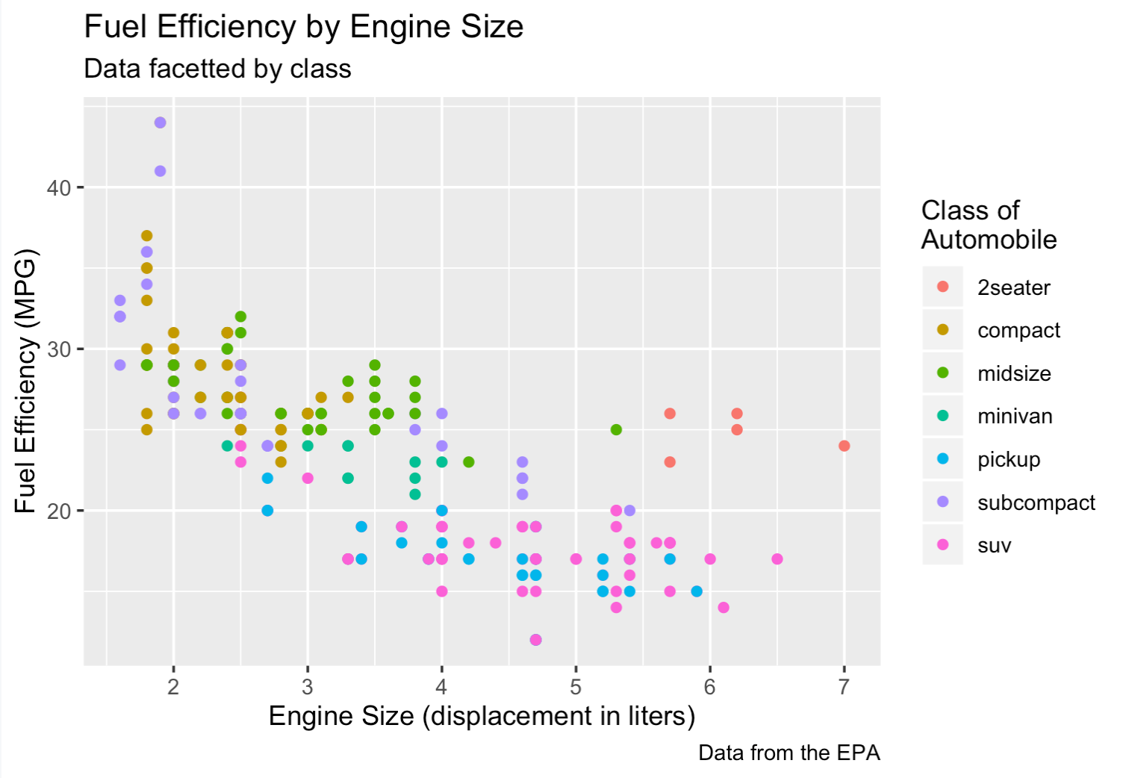





Title
SUBTitle
color
y
caption
x
CC by RStudio

Slide 30
Geoms

Slide 31
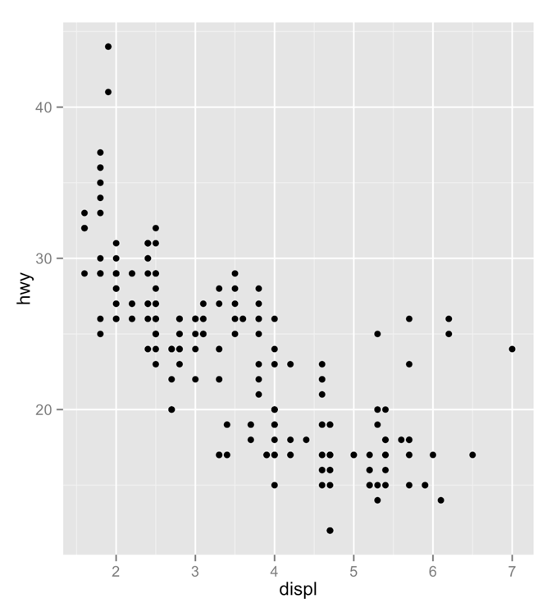
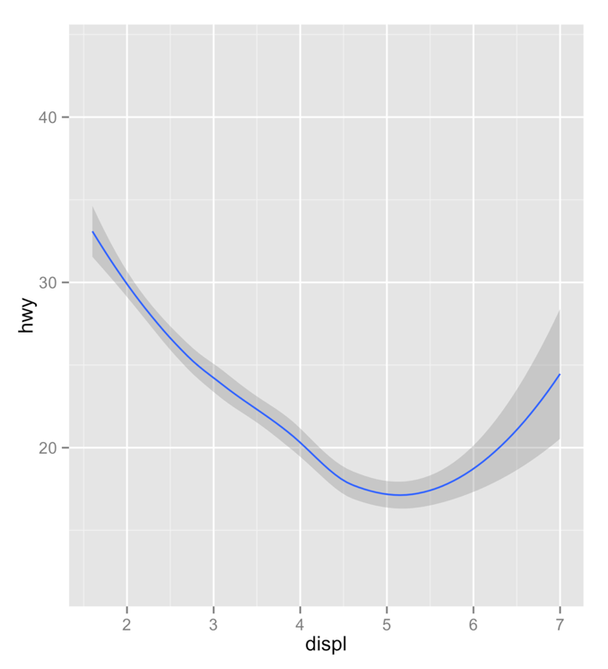
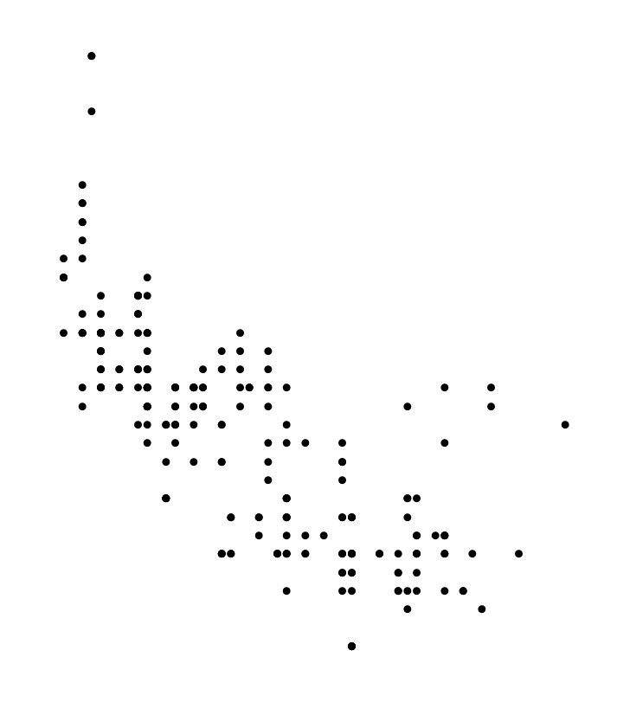
How are these plots similar?
Same:
x var
, y var
, data

Slide 32
How are these plots different?
Different: geometric object (geom),
e.g. the visual object used to represent the data

Slide 33
geoms
ggplot(data = <DATA>) +
<GEOM_FUNCTION>(mapping = aes(<MAPPINGS>))

Slide 34


rstudio.cloud/learn/cheat-sheets
Click
CheAT Sheets
in the sidebar

Slide 35
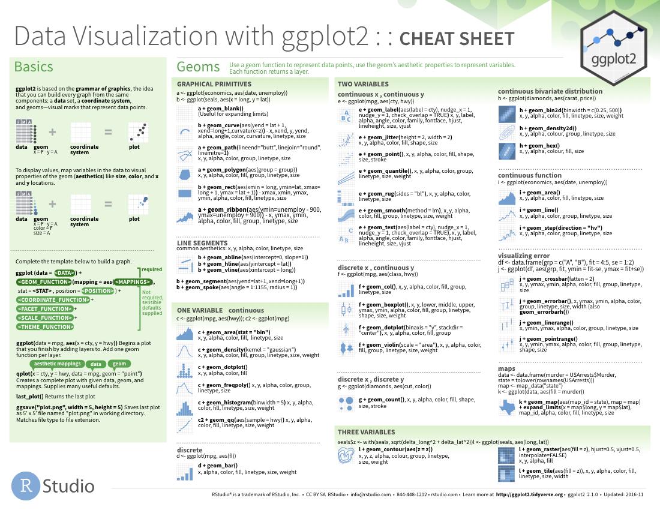
geom_ functions
Each requires a mapping argument.

Slide 36

Your Turn
Pair up.

Slide 37
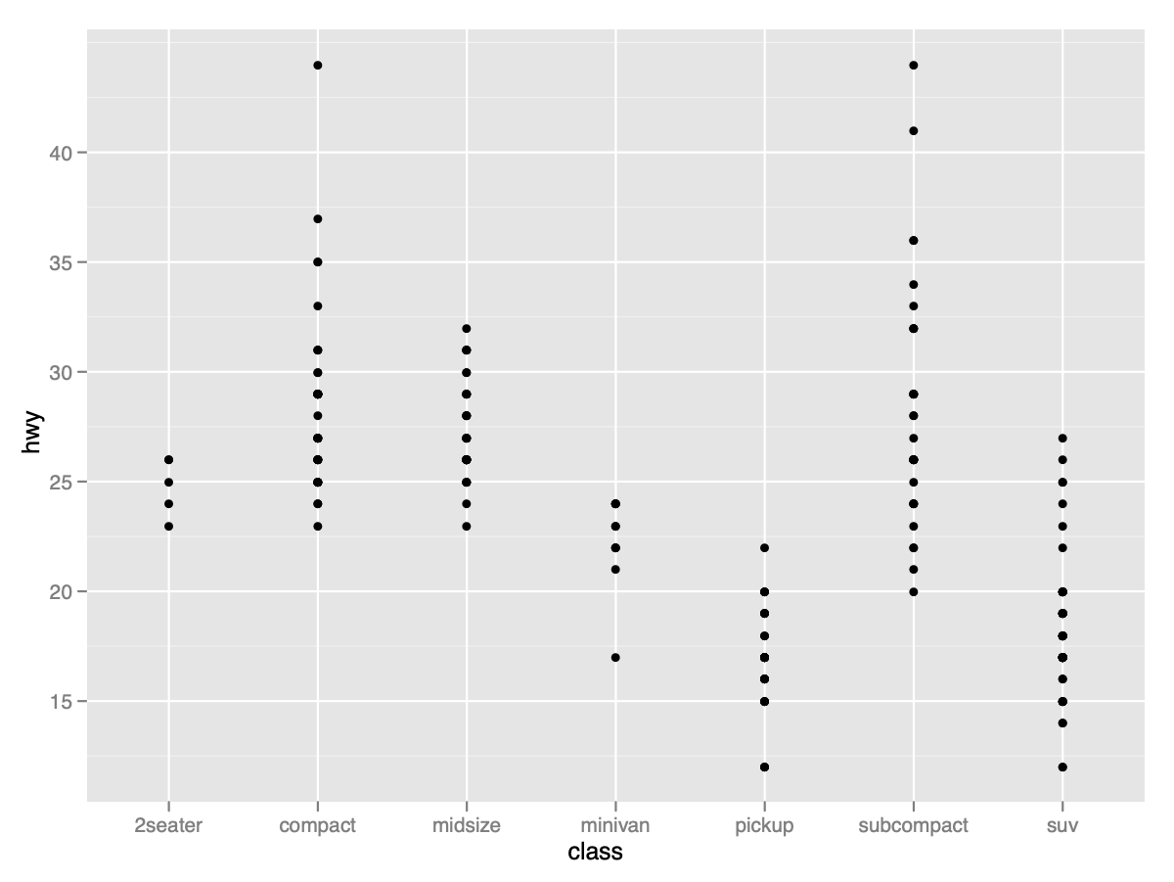
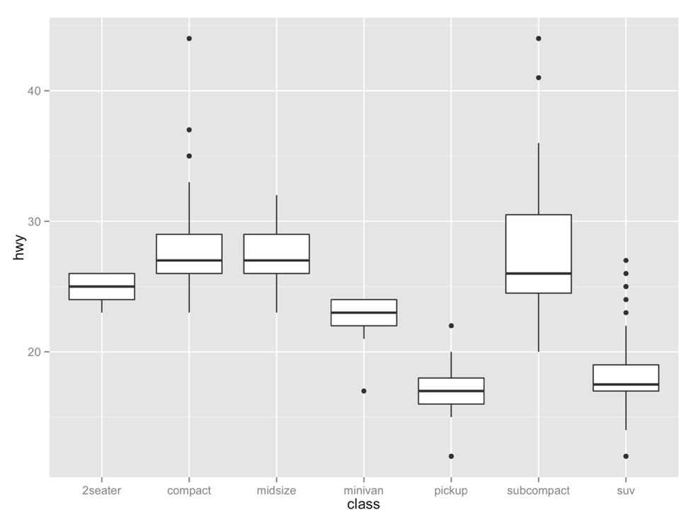
Your Turn 4
With your partner, decide how to replace this scatterplot with one that draws boxplots. Use the cheatsheet. Try your best guess.
ggplot(mpg) + geom_point(aes(class, hwy))

Slide 38
ggplot(data = mpg) +
geom_boxplot(mapping = aes(x = class, y = hwy))

Slide 39
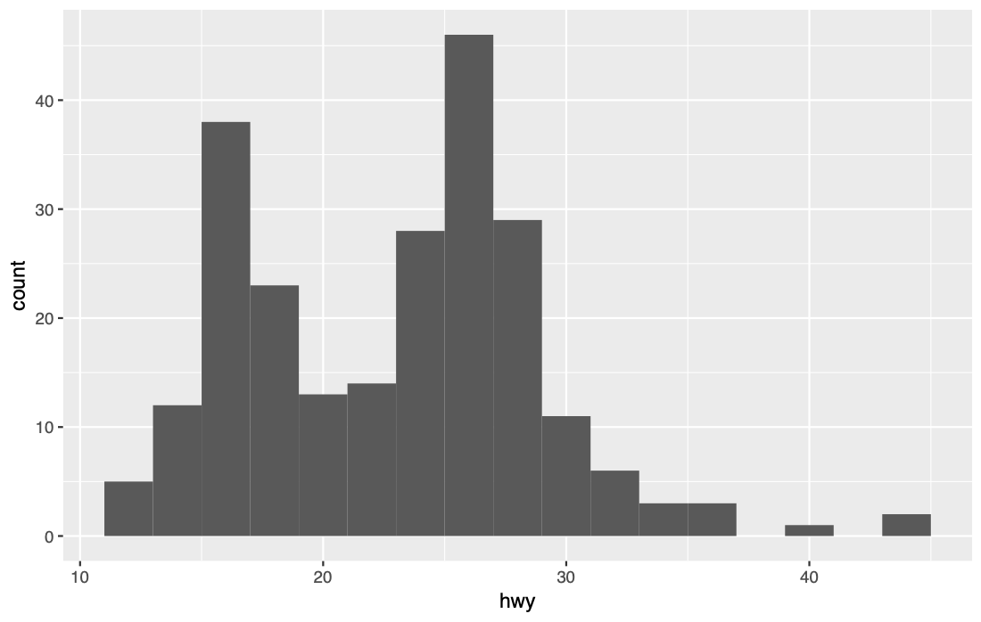
Your Turn 5
With a partner, make the histogram of hwy below. Use the cheatsheet. Hint: do not supply a y variable.

Slide 40
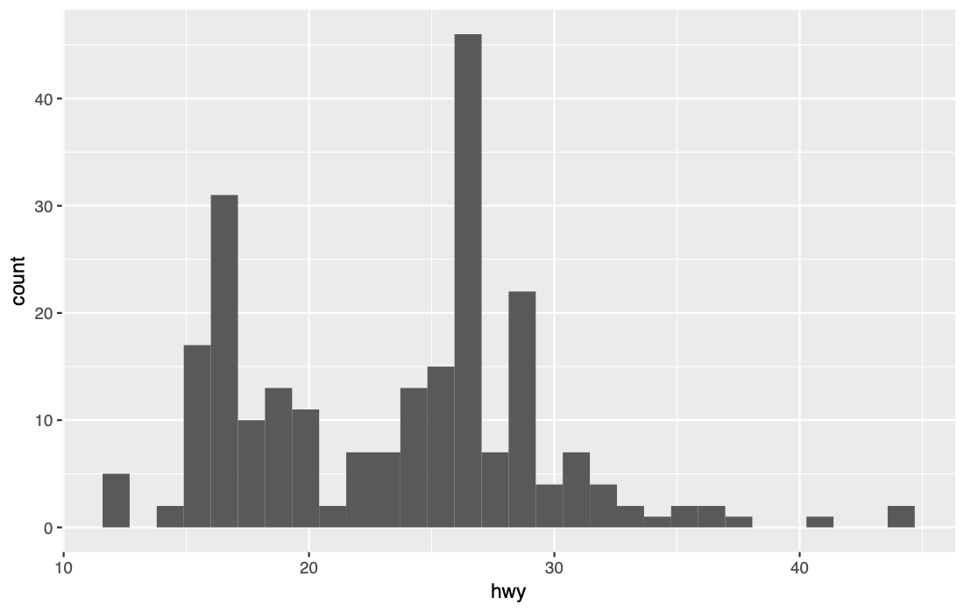
ggplot(data = mpg) +
geom_histogram(mapping = aes(x = hwy))

Slide 41
Quiz
What is the difference?

Slide 42
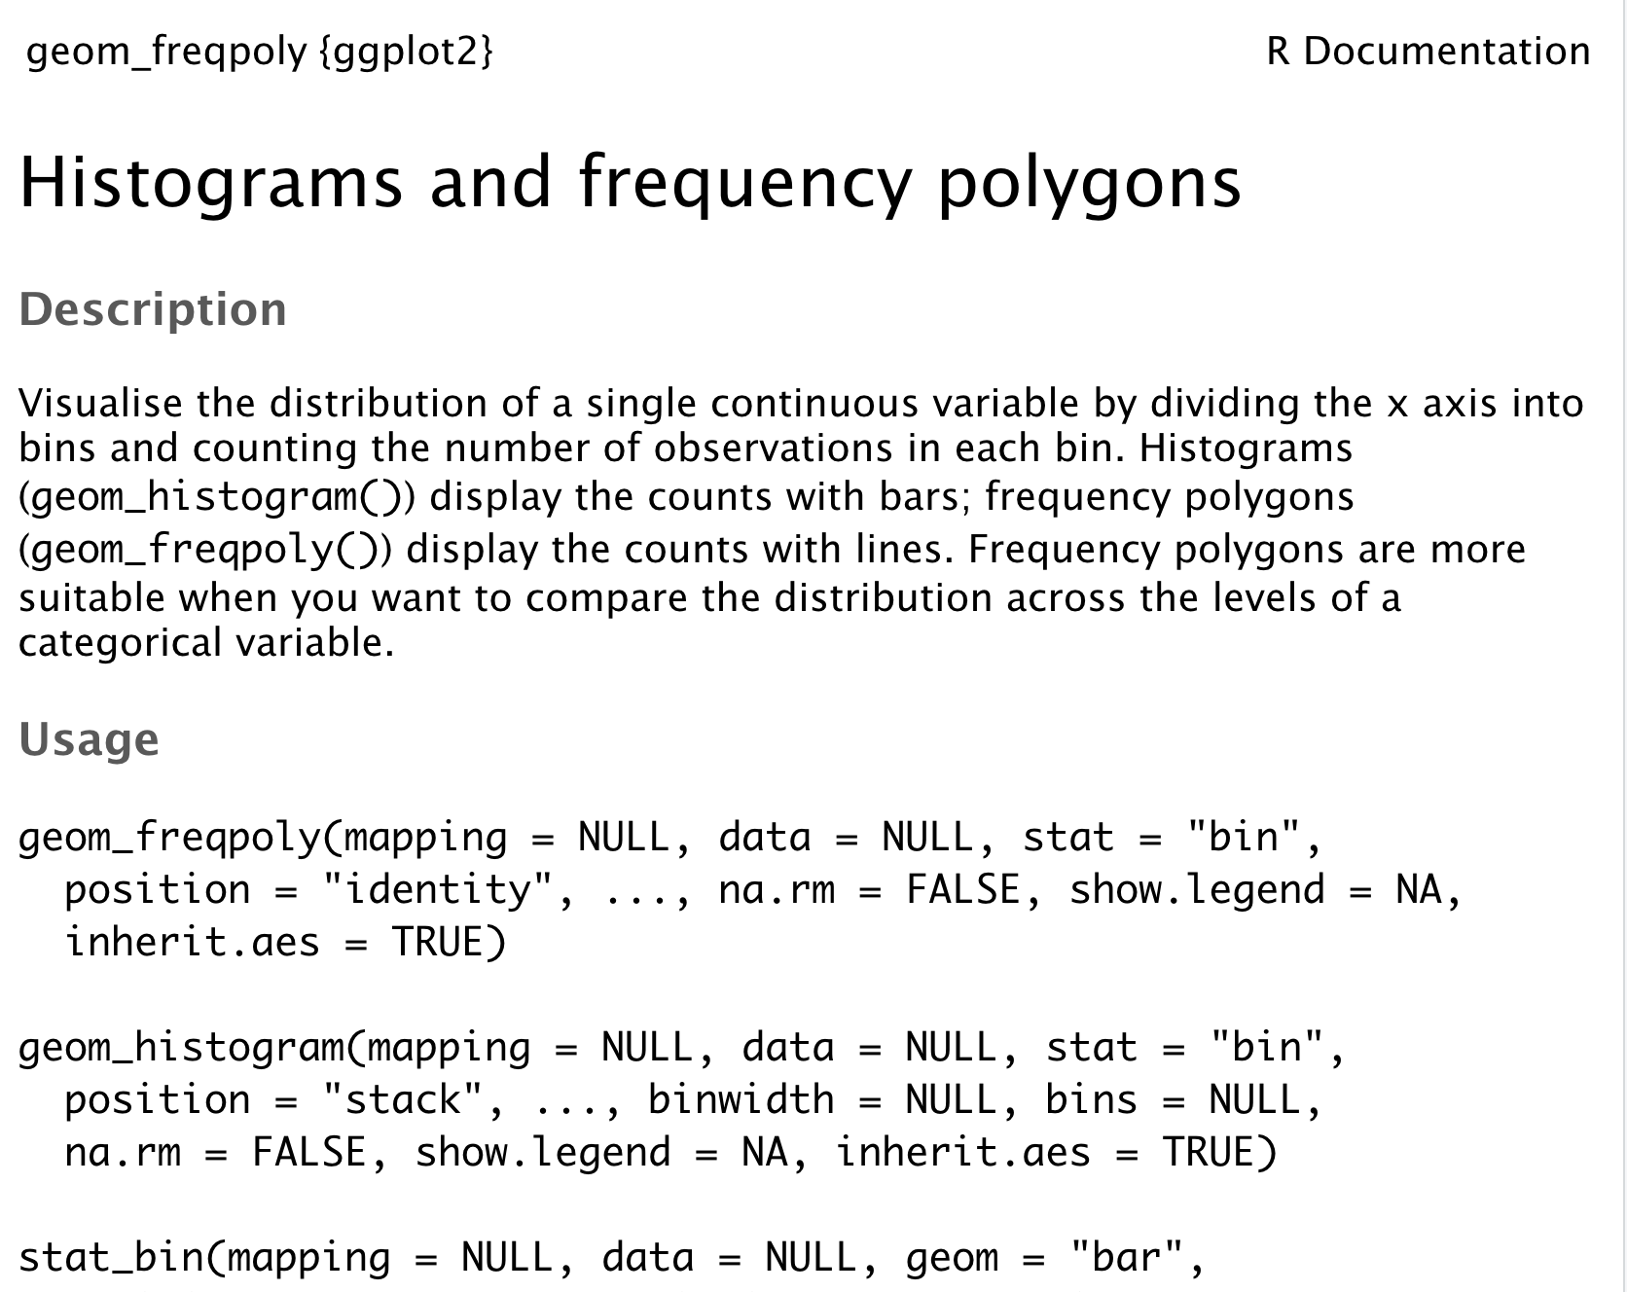
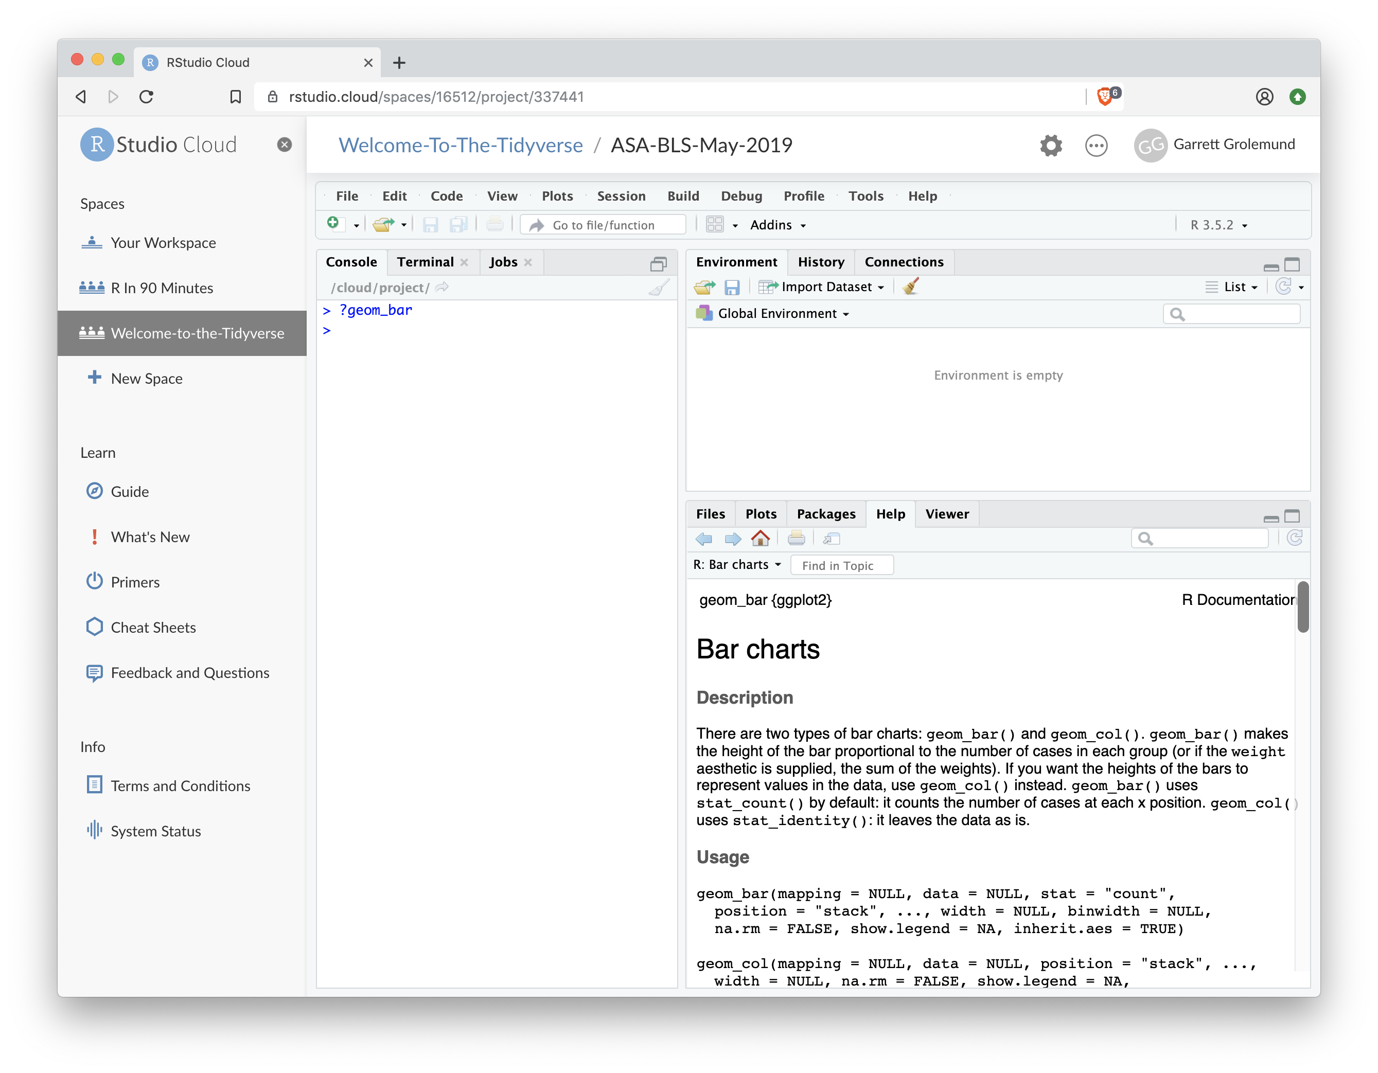
"Help" pages
To open the documentation for a function, type
?geom_histogram
?
function name (no parentheses)

Slide 43
Tips
scan page for relevant info
ignore things that don't make sense
try out the examples

Slide 44
Your Turn 6
Use the help page for geom_histogram to make the bins 2 mpg wide.

Slide 45
ggplot(data = mpg) +
geom_histogram(mapping = aes(x = hwy), binwidth = 2)

Slide 46
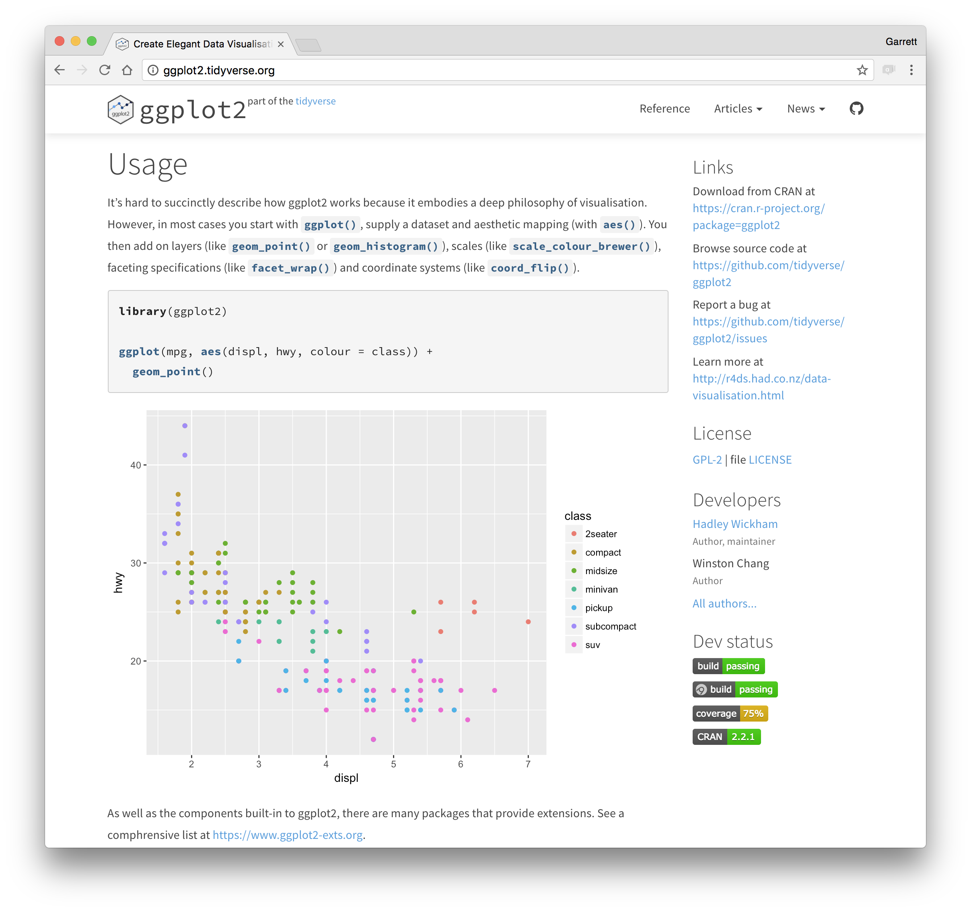
ggplot2.tidyverse.org

Slide 47
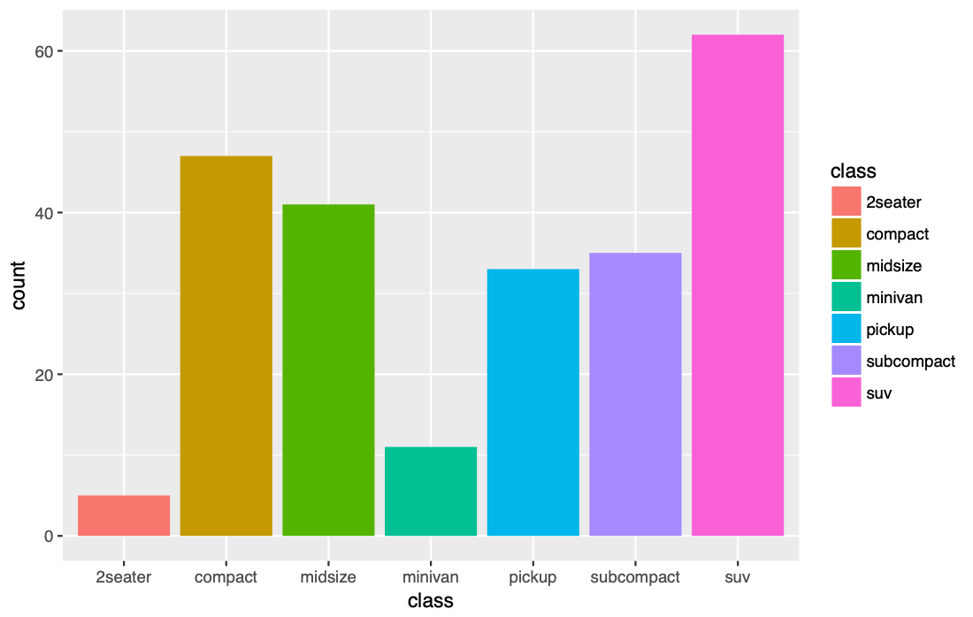
Your Turn 7
With a partner, make the bar chart of class below. Use the cheatsheet. Hint: do not supply a y variable.

Slide 48
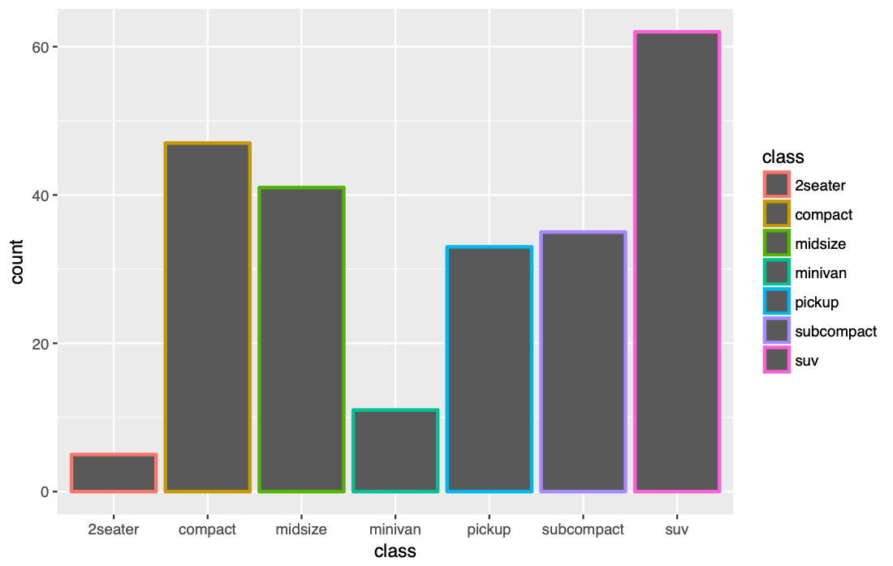
ggplot(data = mpg) +
geom_bar(mapping = aes(x = class, color = class))

Slide 49
ggplot(data = mpg) +
geom_bar(mapping = aes(x = class, fill = class))

Slide 50
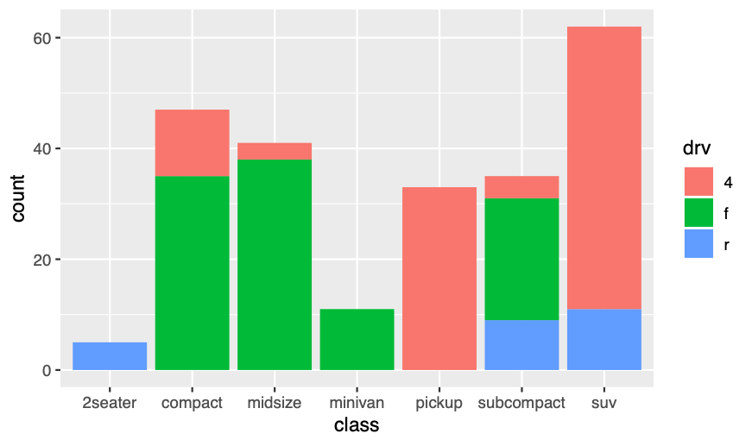
ggplot(data = mpg) +
geom_bar(mapping = aes(x = class, fill = drv))

Slide 51
Quiz
What will this code do?
ggplot(mpg) +
geom_point(aes(displ, hwy)) +
geom_smooth(aes(displ, hwy))

Slide 52
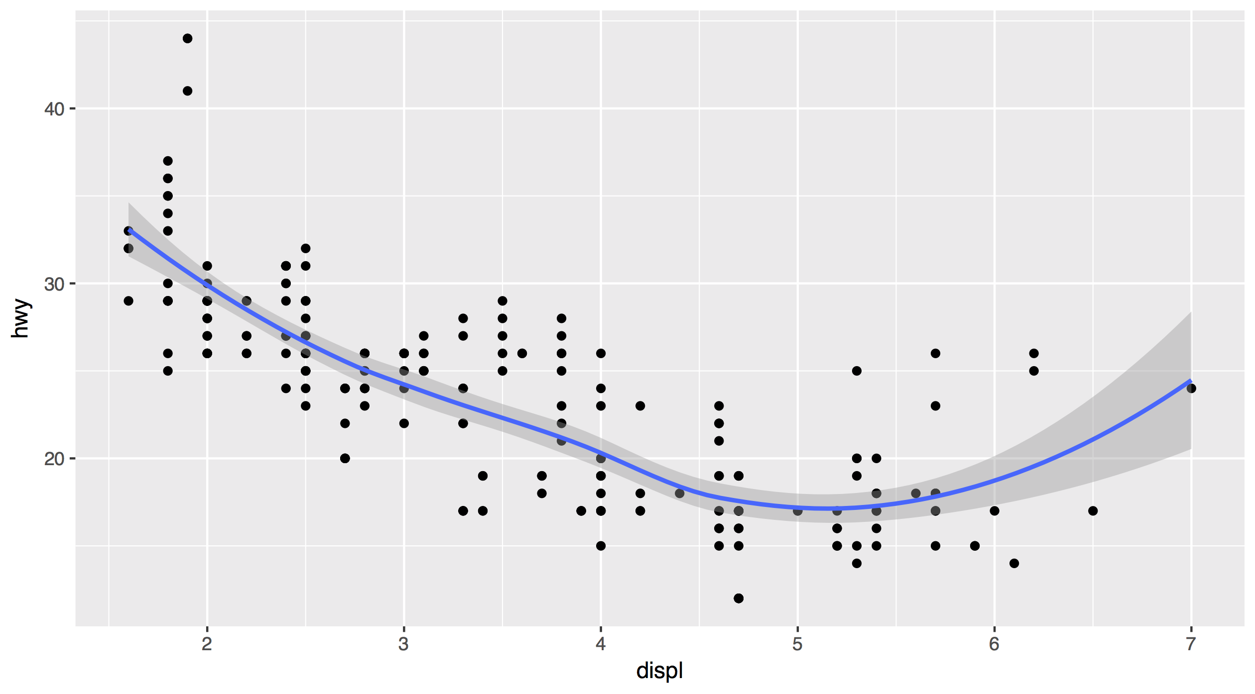
Each new geom adds a new layer
ggplot(data = mpg) +
geom_point(mapping = aes(x = displ, y = hwy)) +
geom_smooth(mapping = aes(x = displ, y = hwy))

Slide 53
Each new geom adds a new layer
ggplot(data = mpg) +
geom_point(mapping = aes(x = displ, y = hwy)) +
geom_smooth(mapping = aes(x = displ, y = hwy))

Slide 54
global vs. local

Slide 55
Mappings (and data) that appear in ggplot() will apply globally to every layer
ggplot(data = mpg, mapping = aes(x = displ, y = hwy)) +
geom_point() +
geom_smooth()

Slide 56
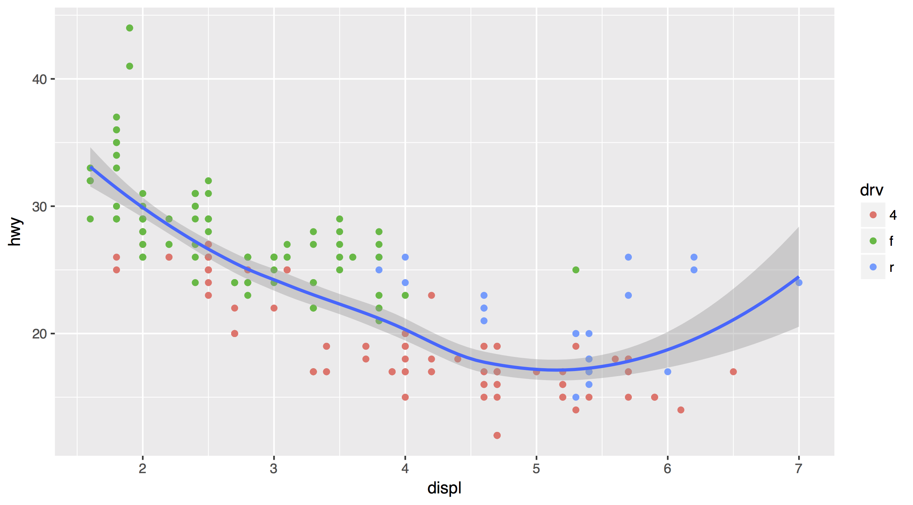
Mappings (and data) that appear in a geom_ function will add to or override the global mappings for that layer only
ggplot(data = mpg, mapping = aes(x = displ, y = hwy)) +
geom_point(mapping = aes(color = drv)) +
geom_smooth()

Slide 57
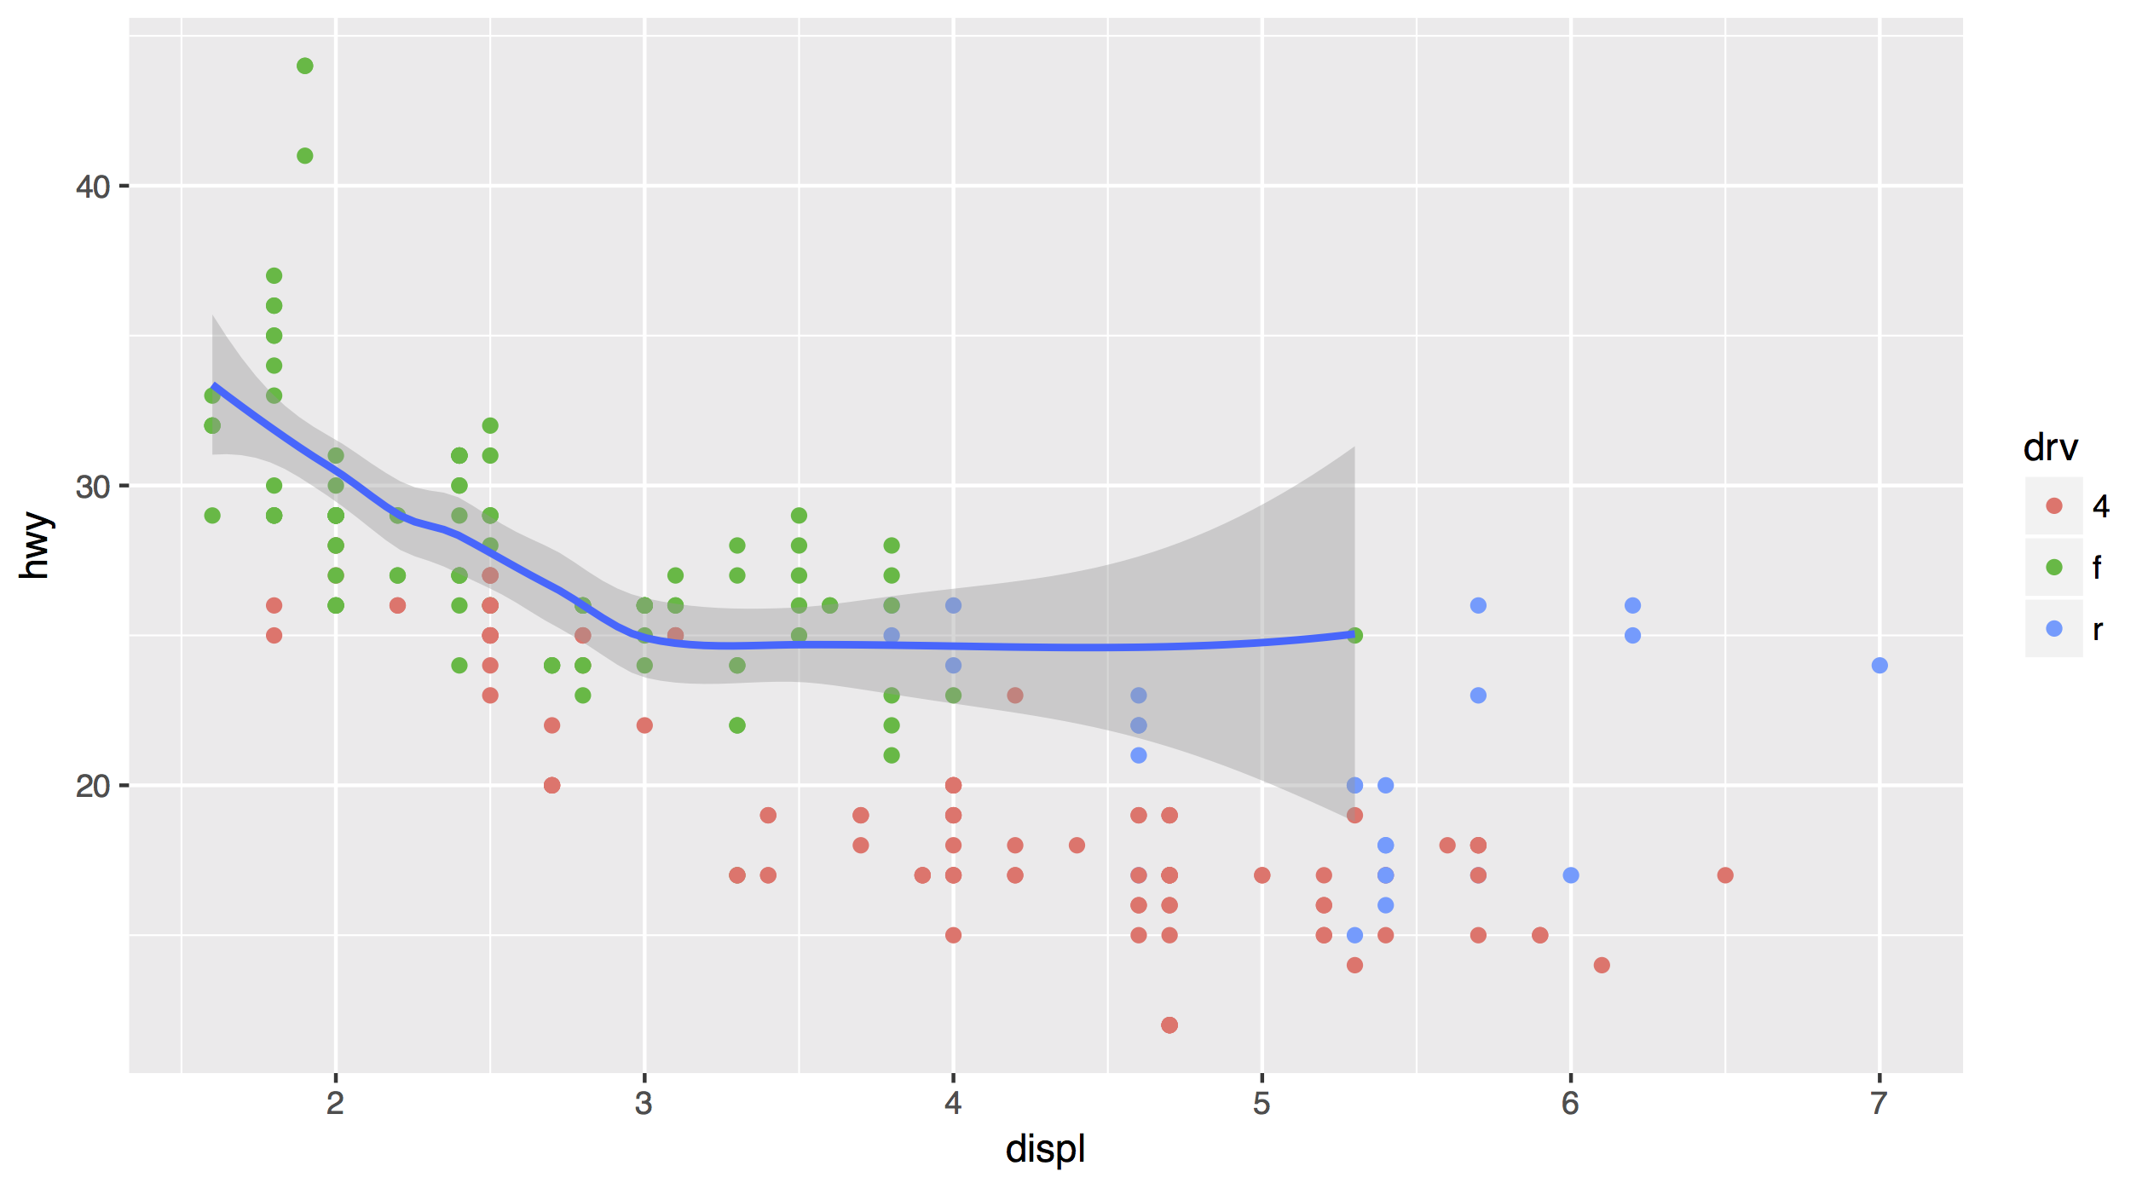
data can also be set locally or globally
ggplot(data = mpg, mapping = aes(x = displ, y = hwy)) +
geom_point(mapping = aes(color = drv)) +
geom_smooth(data = filter(mpg, drv == "f"))

Slide 58
Quiz
What is different about this plot? Run the code!
p <- ggplot(mpg) +
geom_point(aes(displ, hwy)) +
geom_smooth(aes(displ, hwy))
library(plotly)
ggplotly(p)

Slide 59
interactivity

Slide 60
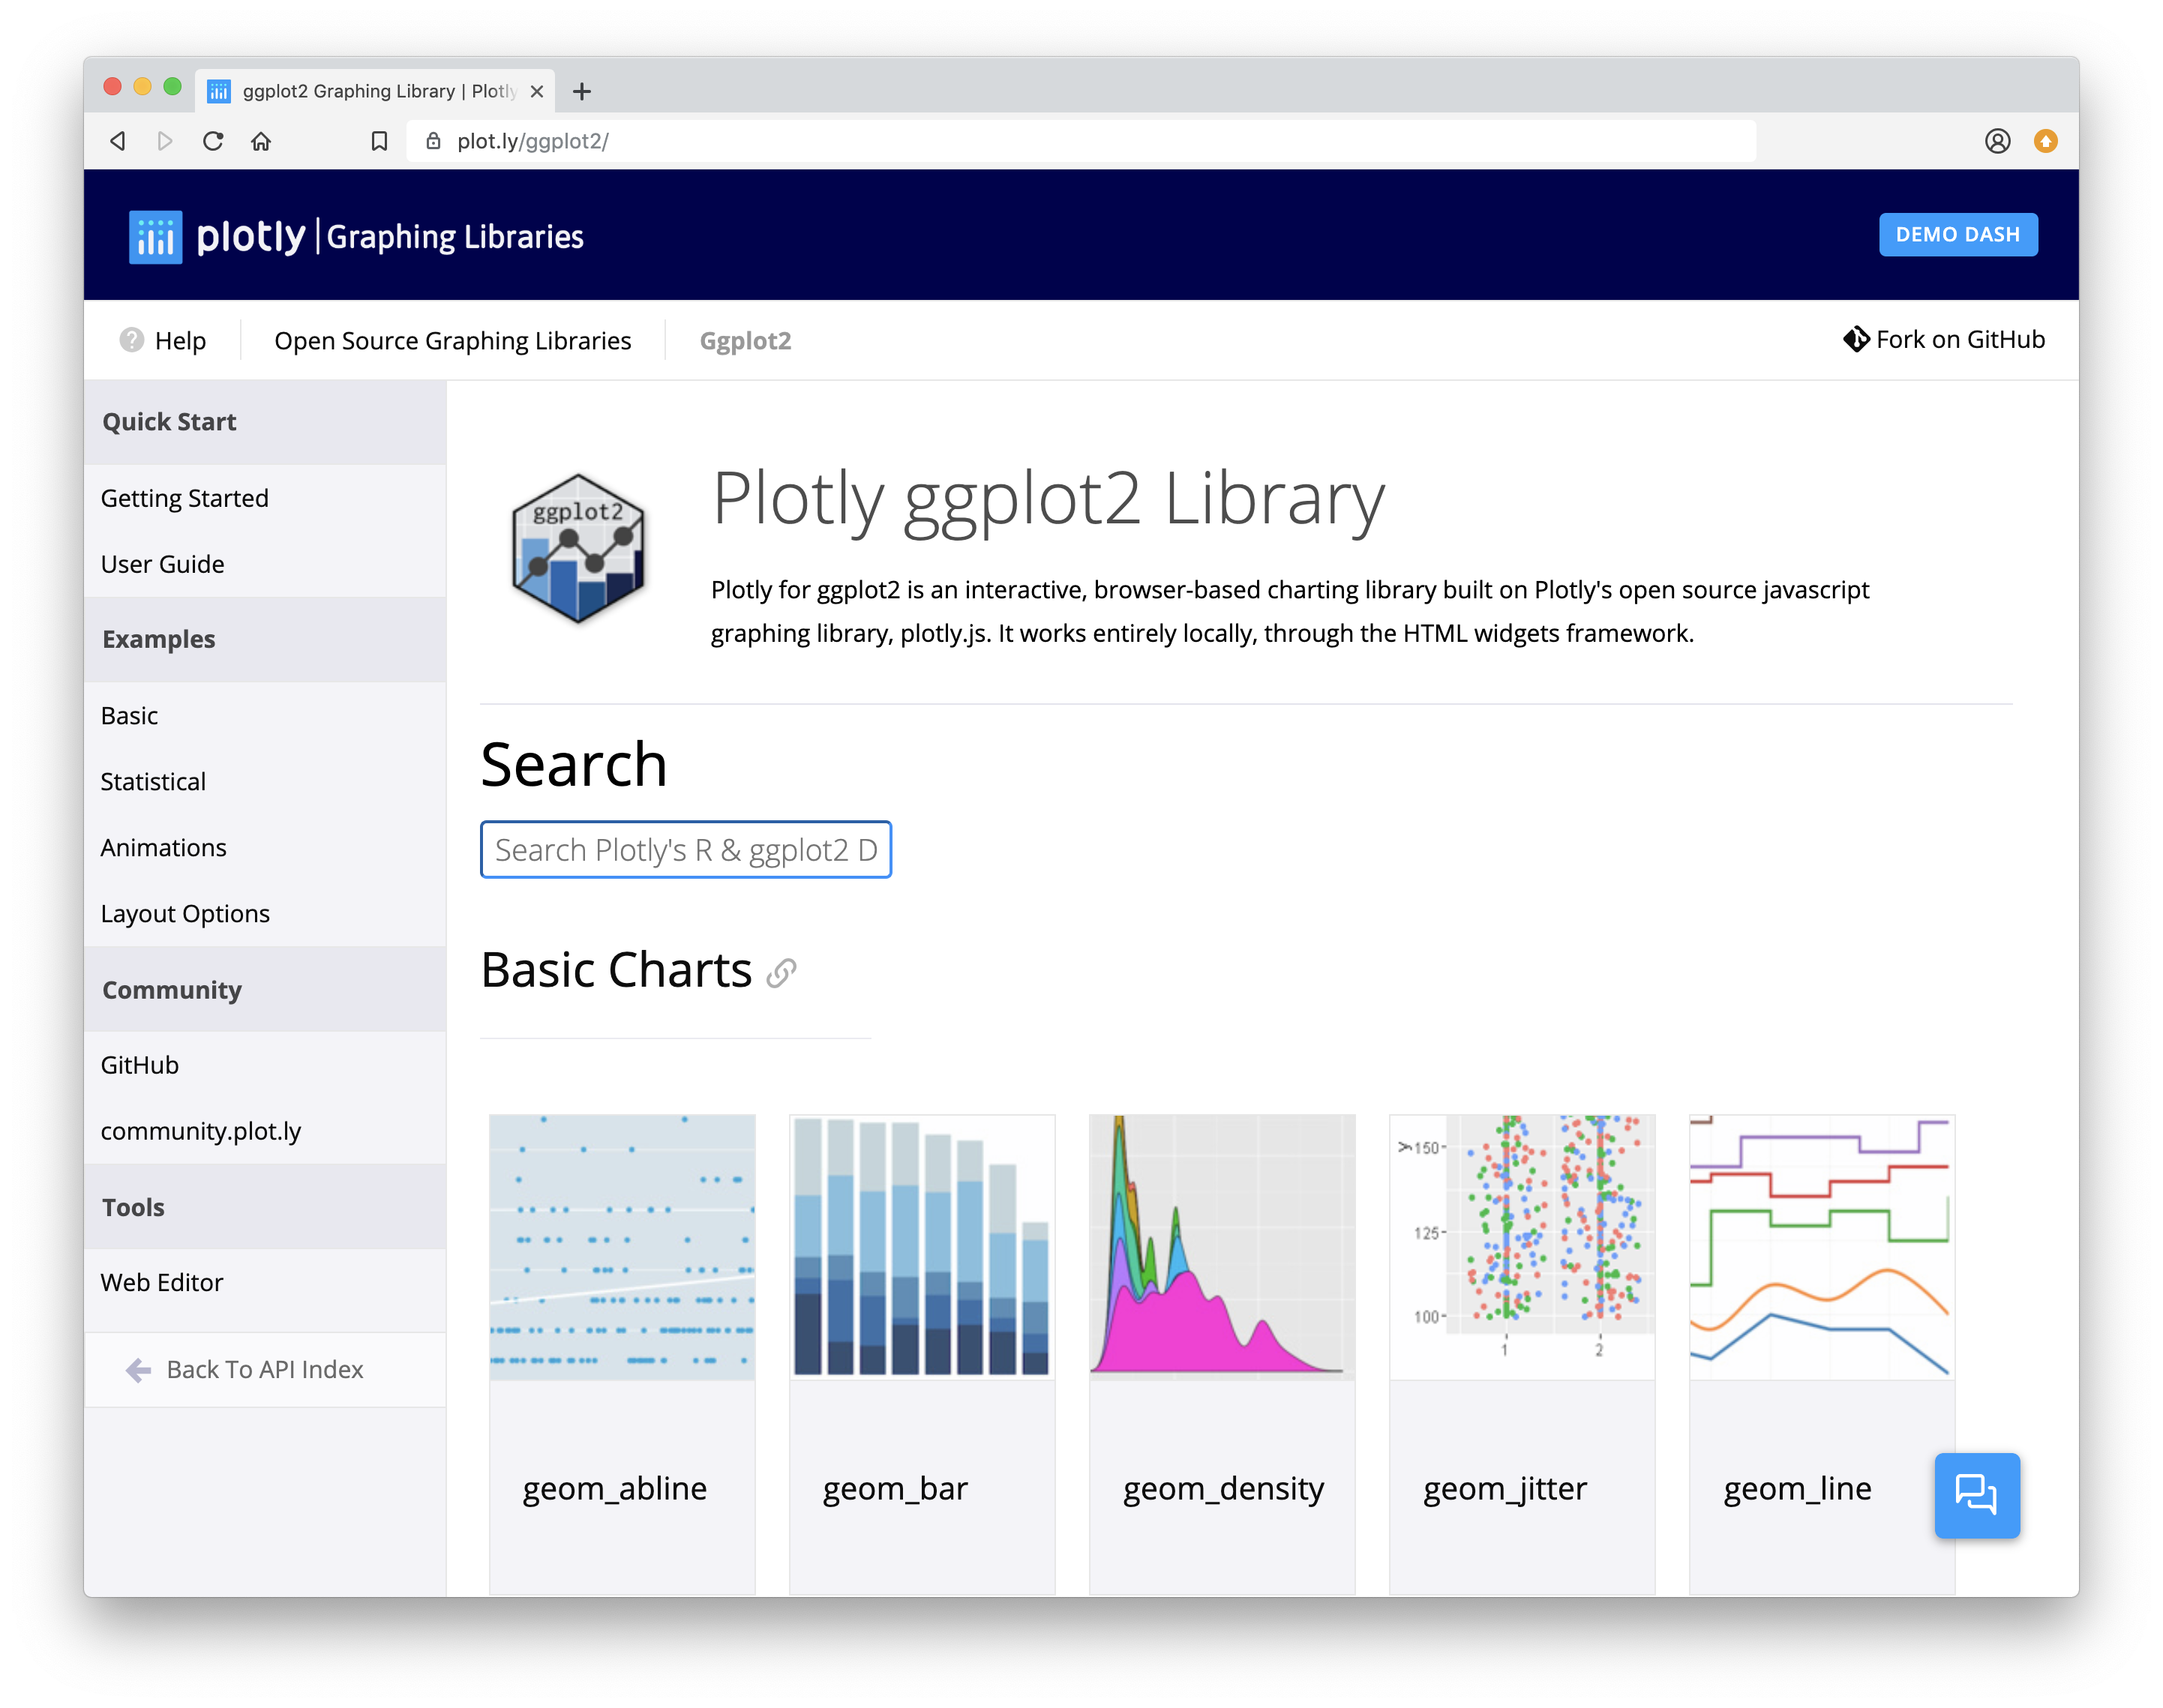
Plotly
Tools for making interactive plots. plot.ly/ggplot2/

Slide 61
Saving
graphs

Slide 62
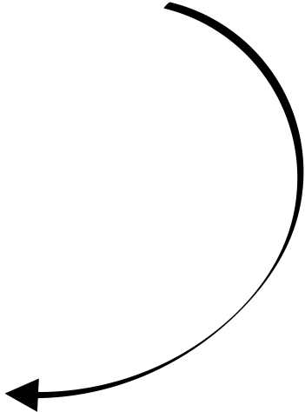
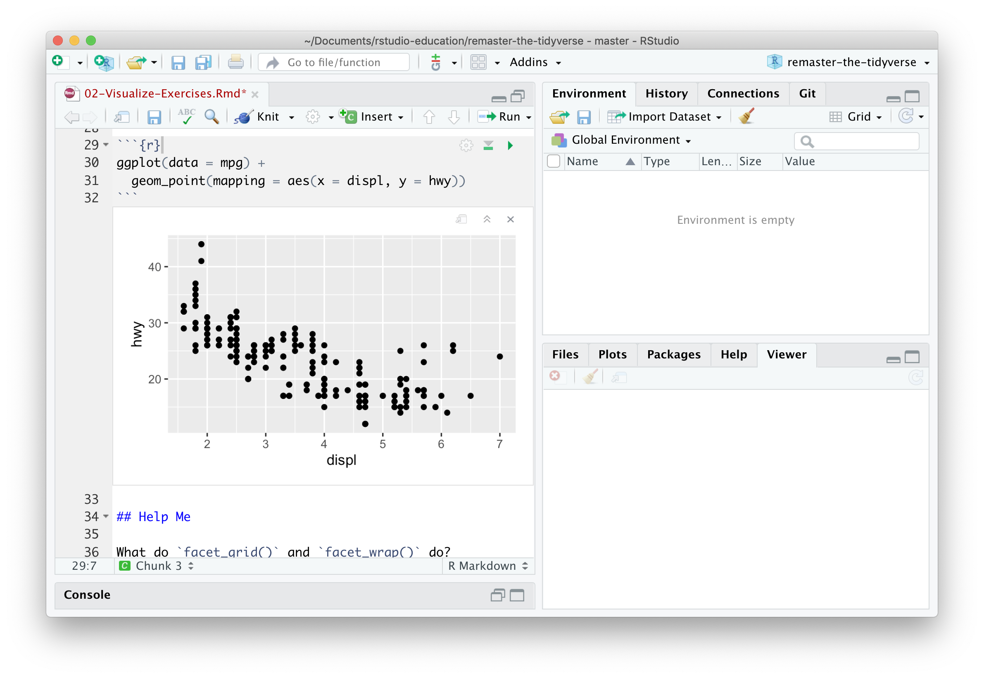
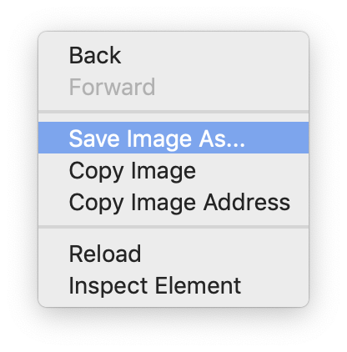
GUI method
Right click on the plot

Slide 63
Code method
ggsave() saves the last plot.
Uses size on screen:
ggsave("my-plot.pdf")
ggsave("my-plot.png")
Q: But where will
it save it?
A: Alongside
your .Rmd
Specify size in inches
ggsave("my-plot.pdf", width = 6, height = 6)

Slide 64
Your Turn 8
What does this command return?
getwd()

Slide 65
Working directory
R associates itself with a folder (i.e. directory) on your computer.
This folder is known as your "working directory"
When you save files, R will save them here
When you load files, R will look for them here

Slide 66
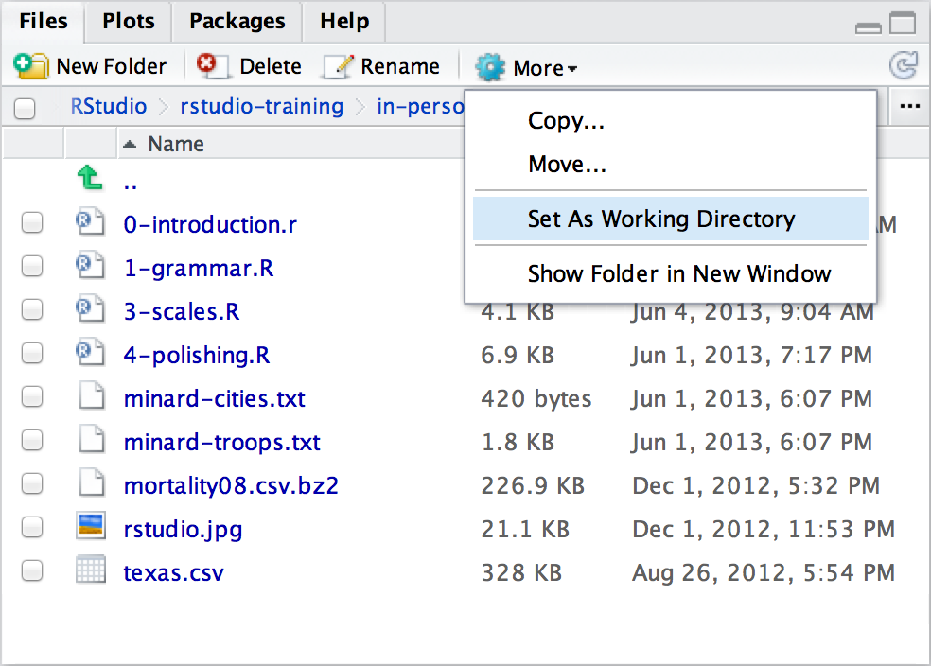
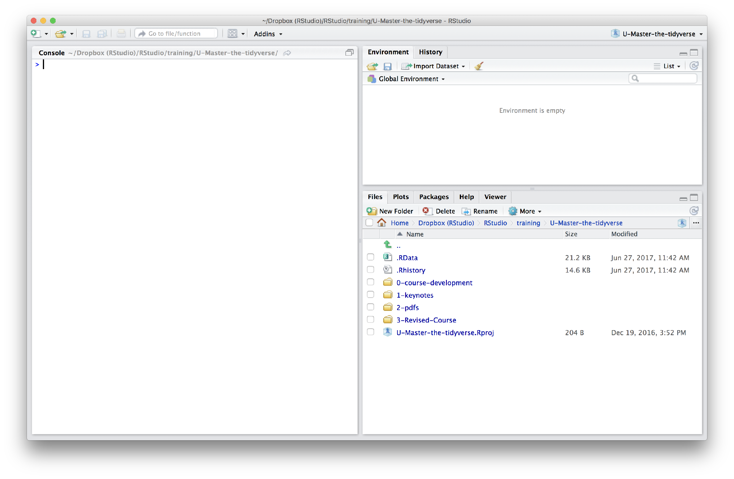
Changing the Working directory
Navigate in the files pane to a new directory. Click
More > Set As Working Directory

Slide 67
Plotly
Save with
htmlwidgets::saveWidget()
Tools for making interactive plots. plot.ly/ggplot2/

Slide 68
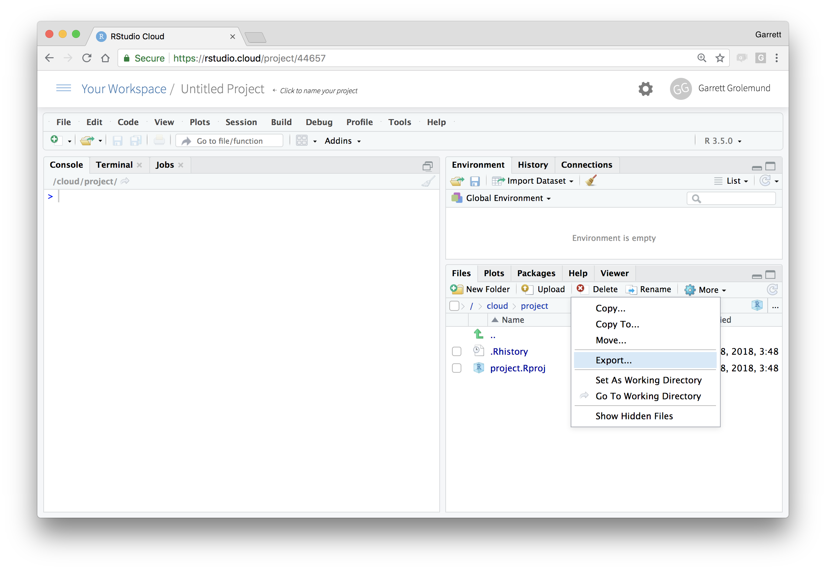
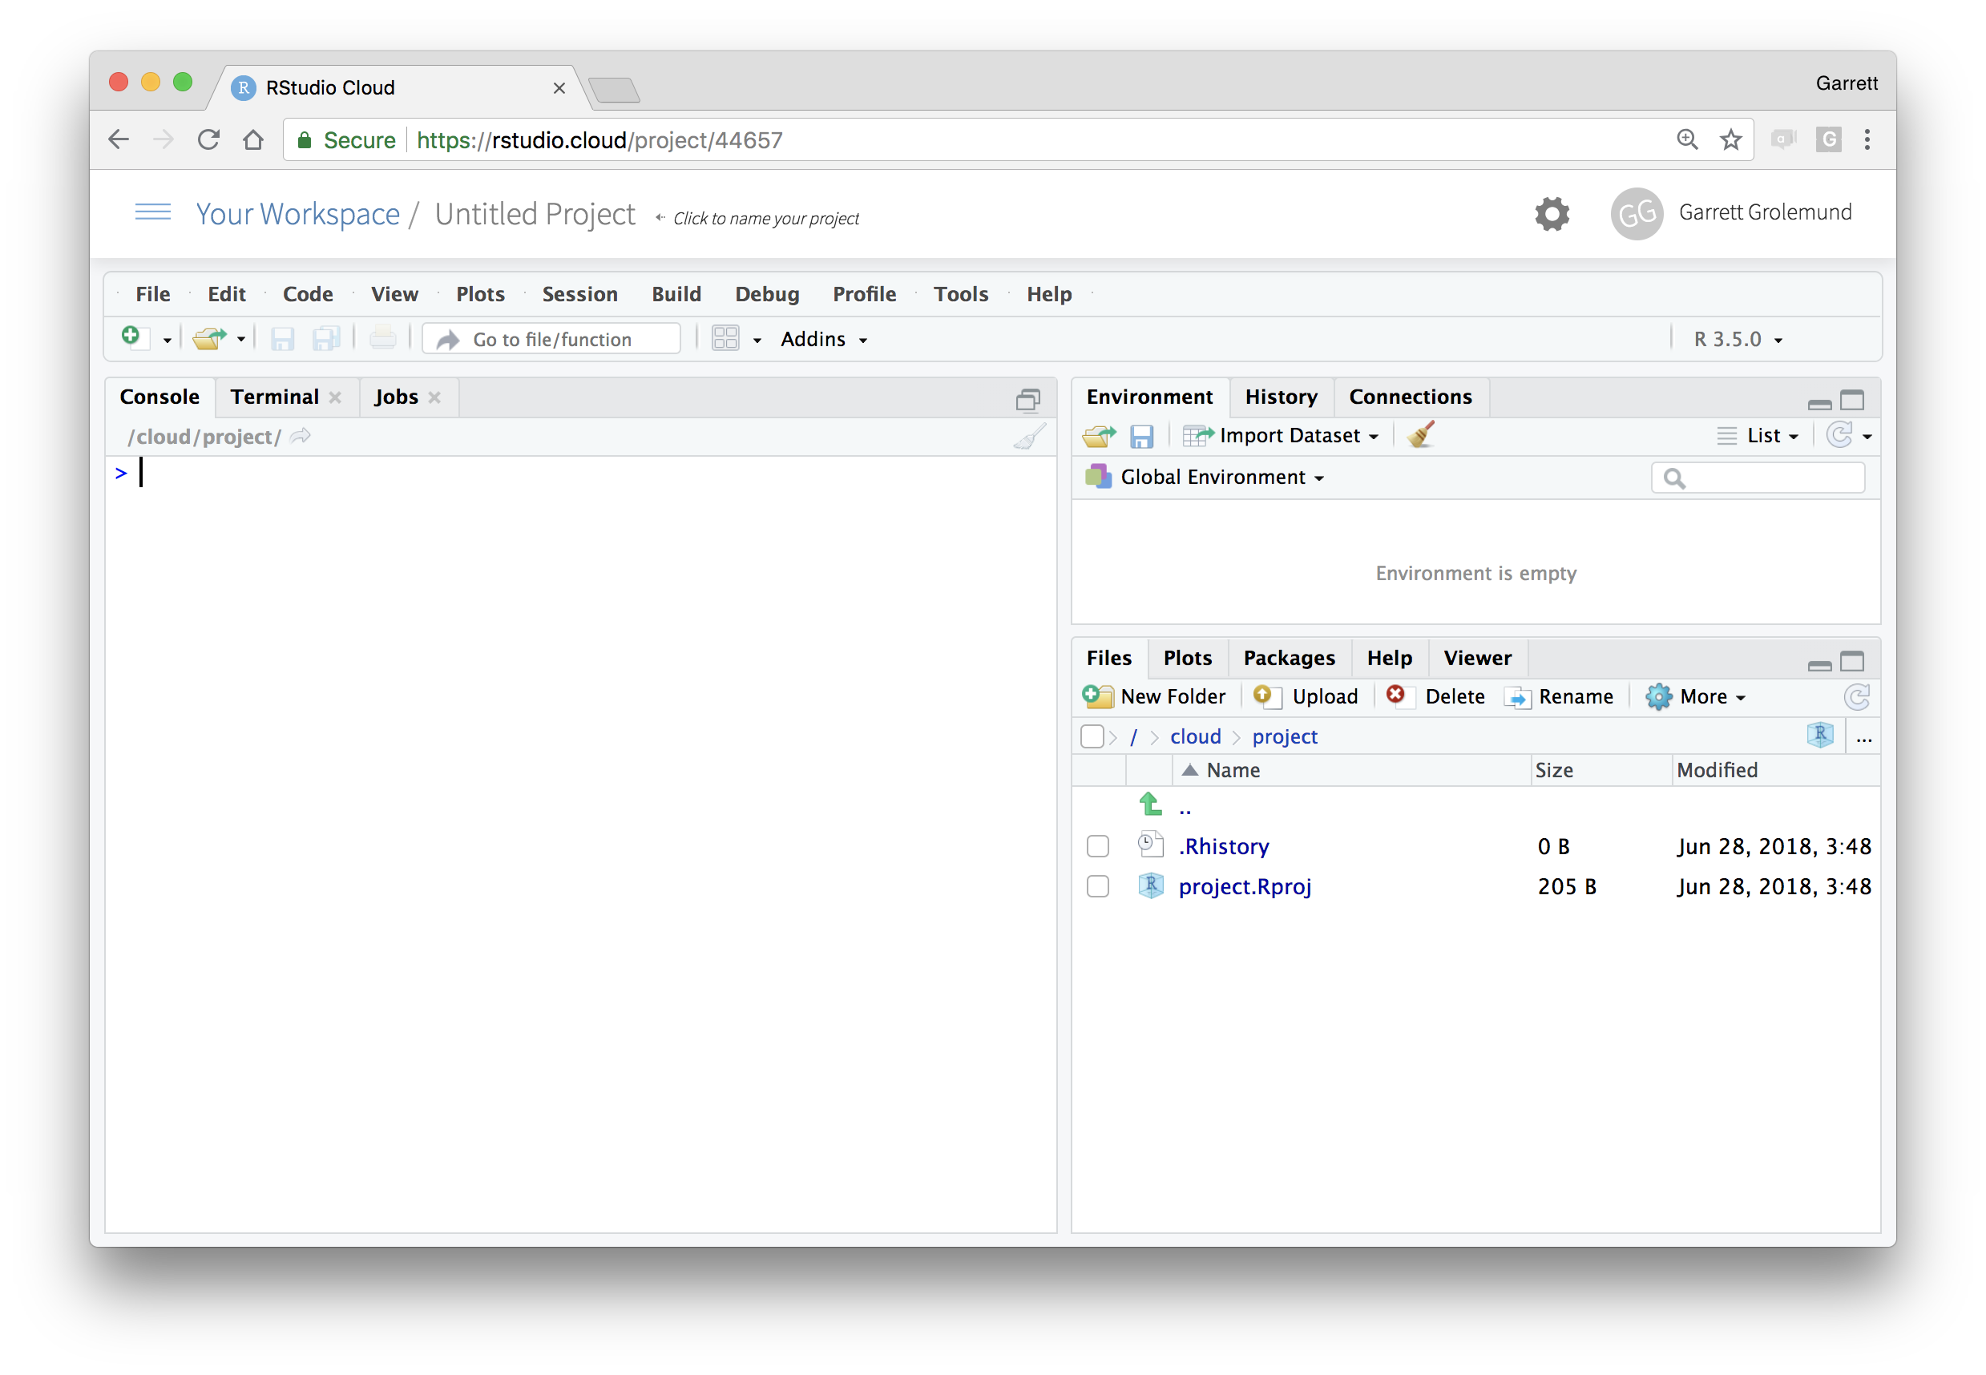
Download files
In the files pane, check next to the file(s) to download
More > Export

Slide 69
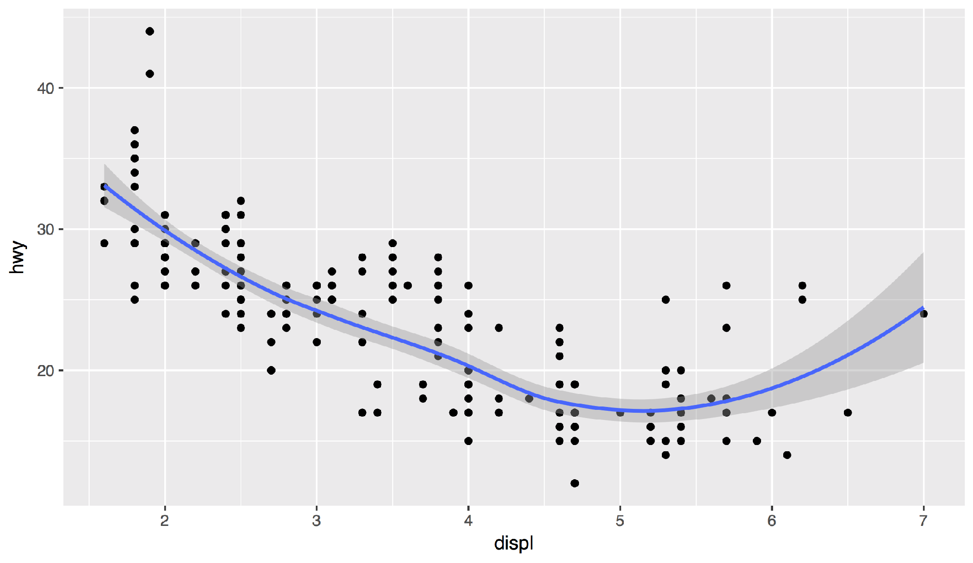
Your Turn 8
Save your last plot and then locate it in your files pane and download it. (You may have to refresh the files list).

Slide 70
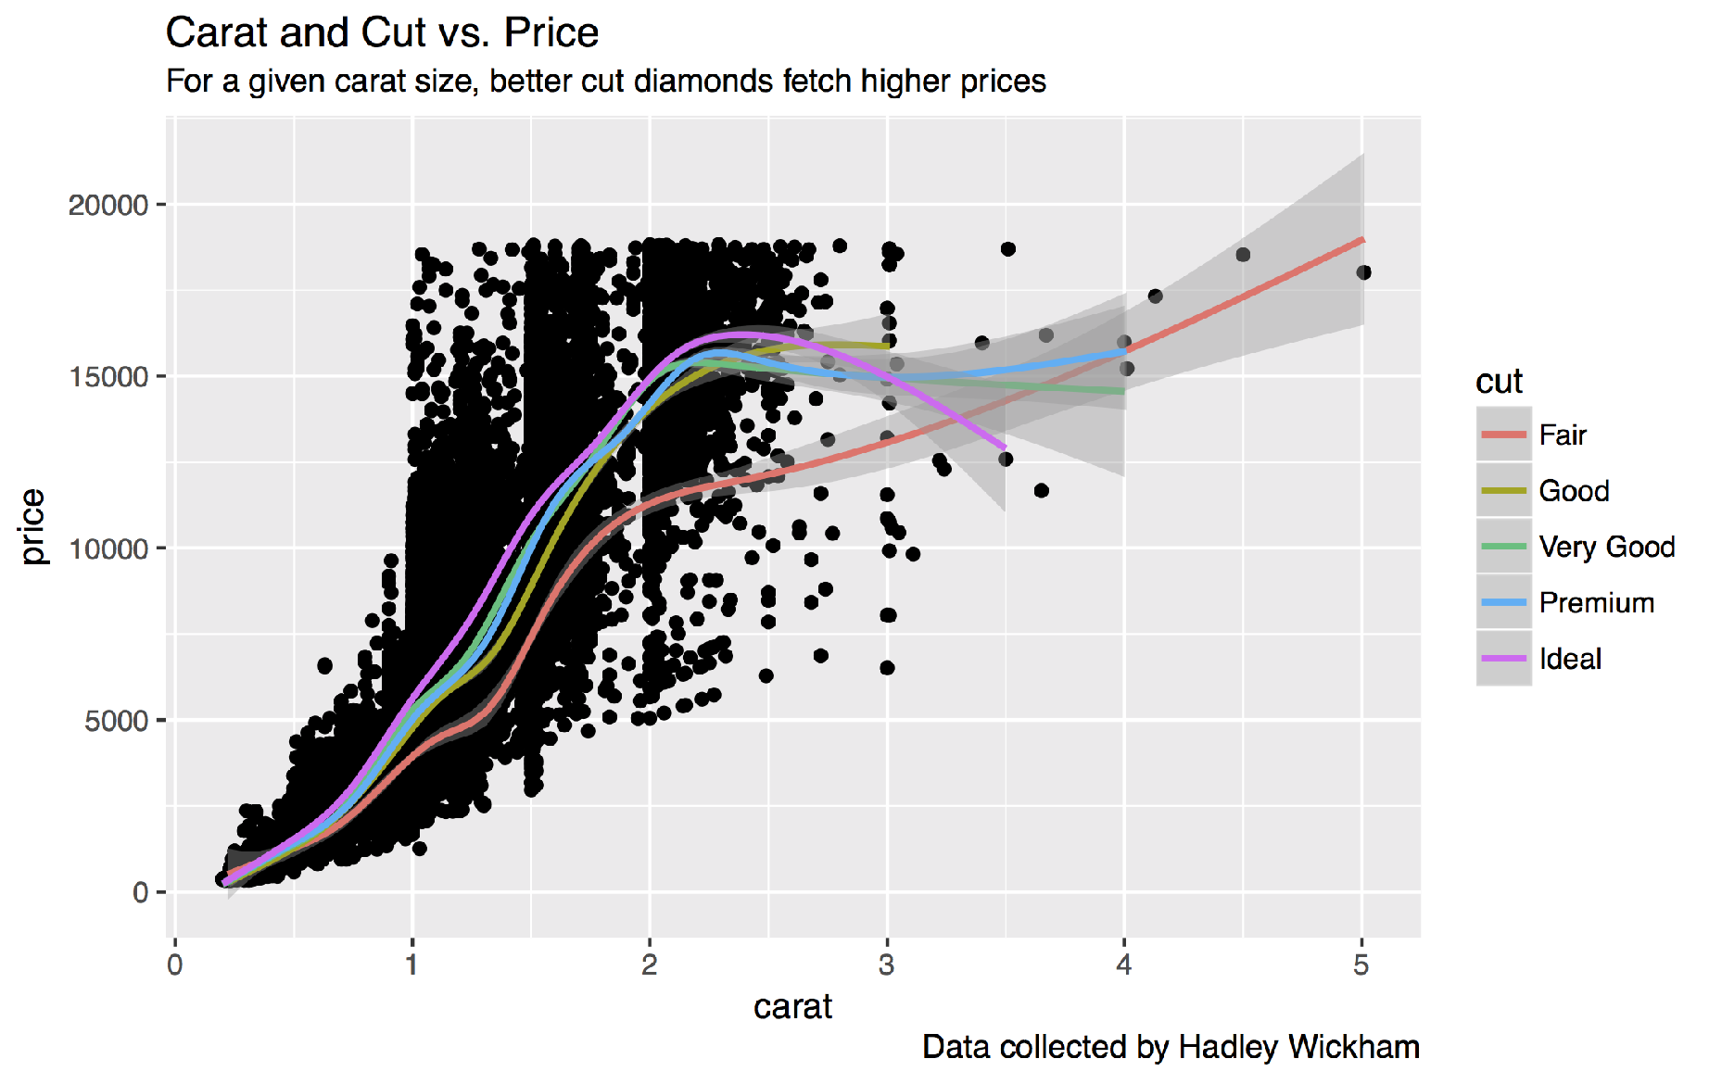
Your turn
Save your last plot and then locate it in your files pane.

Slide 71
Grammar
of Graphics

Slide 72
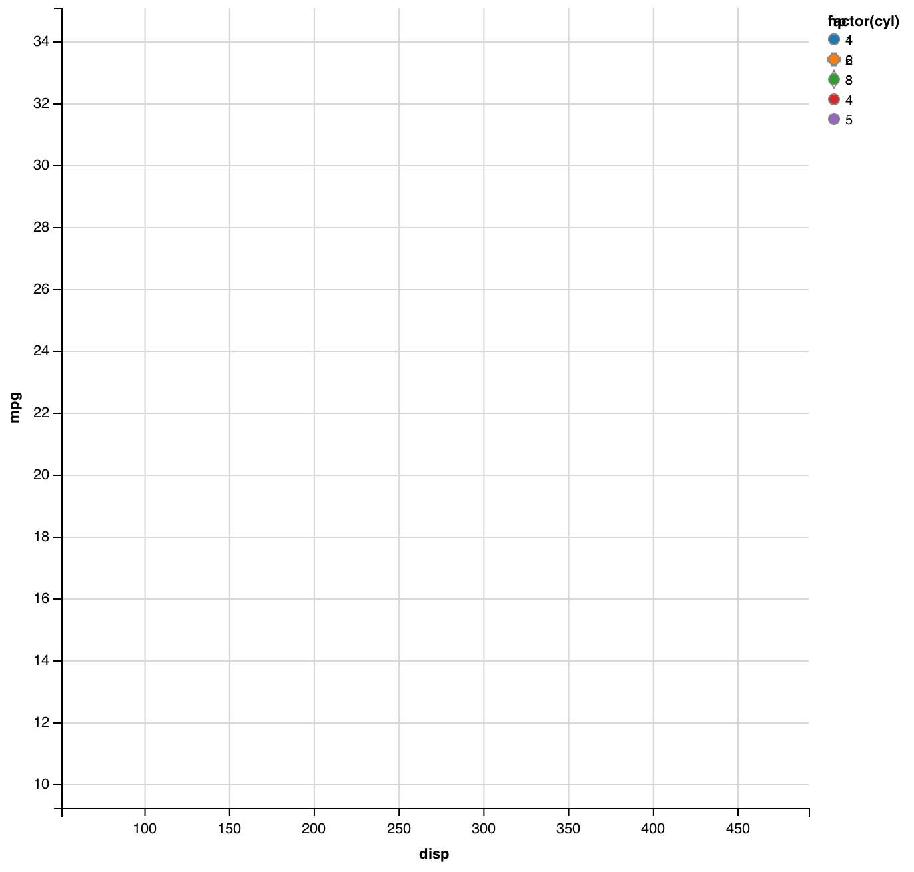
mpg | cyl | disp | hp
21.0 | 6 | 160.0 | 2
21.0 | 6 | 160.0 | 2
22.8 | 4 | 108.0 | 1
21.4 | 6 | 258.0 | 2
18.7 | 8 | 360.0 | 3
18.1 | 6 | 225.0 | 2
14.3 | 8 | 360.0 | 5
24.4 | 4 | 146.7 | 1
22.8 | 4 | 140.8 | 1
19.2 | 6 | 167.6 | 2
17.8 | 6 | 167.6 | 2
16.4 | 8 | 275.8 | 3
17.3 | 8 | 275.8 | 3
15.2 | 8 | 275.8 | 3
10.4 | 8 | 472.0 | 4
10.4 | 8 | 460.0 | 4
14.7 | 8 | 440.0 | 4
32.4 | 4 | 78.7 | 1
30.4 | 4 | 75.7 | 1
33.9 | 4 | 71.1 | 1
data
geom

Slide 73
mappings
fill
mpg | cyl | disp | hp
21.0 | 6 | 160.0 | 2
21.0 | 6 | 160.0 | 2
22.8 | 4 | 108.0 | 1
21.4 | 6 | 258.0 | 2
18.7 | 8 | 360.0 | 3
18.1 | 6 | 225.0 | 2
14.3 | 8 | 360.0 | 5
24.4 | 4 | 146.7 | 1
22.8 | 4 | 140.8 | 1
19.2 | 6 | 167.6 | 2
17.8 | 6 | 167.6 | 2
16.4 | 8 | 275.8 | 3
17.3 | 8 | 275.8 | 3
15.2 | 8 | 275.8 | 3
10.4 | 8 | 472.0 | 4
10.4 | 8 | 460.0 | 4
14.7 | 8 | 440.0 | 4
32.4 | 4 | 78.7 | 1
30.4 | 4 | 75.7 | 1
33.9 | 4 | 71.1 | 1
data
geom

Slide 74
mappings
shape
fill
mpg | cyl | disp | hp
21.0 | 6 | 160.0 | 2
21.0 | 6 | 160.0 | 2
22.8 | 4 | 108.0 | 1
21.4 | 6 | 258.0 | 2
18.7 | 8 | 360.0 | 3
18.1 | 6 | 225.0 | 2
14.3 | 8 | 360.0 | 5
24.4 | 4 | 146.7 | 1
22.8 | 4 | 140.8 | 1
19.2 | 6 | 167.6 | 2
17.8 | 6 | 167.6 | 2
16.4 | 8 | 275.8 | 3
17.3 | 8 | 275.8 | 3
15.2 | 8 | 275.8 | 3
10.4 | 8 | 472.0 | 4
10.4 | 8 | 460.0 | 4
14.7 | 8 | 440.0 | 4
32.4 | 4 | 78.7 | 1
30.4 | 4 | 75.7 | 1
33.9 | 4 | 71.1 | 1
data
geom

Slide 75
mappings
shape
x
fill
mpg | cyl | disp | hp
21.0 | 6 | 160.0 | 2
21.0 | 6 | 160.0 | 2
22.8 | 4 | 108.0 | 1
21.4 | 6 | 258.0 | 2
18.7 | 8 | 360.0 | 3
18.1 | 6 | 225.0 | 2
14.3 | 8 | 360.0 | 5
24.4 | 4 | 146.7 | 1
22.8 | 4 | 140.8 | 1
19.2 | 6 | 167.6 | 2
17.8 | 6 | 167.6 | 2
16.4 | 8 | 275.8 | 3
17.3 | 8 | 275.8 | 3
15.2 | 8 | 275.8 | 3
10.4 | 8 | 472.0 | 4
10.4 | 8 | 460.0 | 4
14.7 | 8 | 440.0 | 4
32.4 | 4 | 78.7 | 1
30.4 | 4 | 75.7 | 1
33.9 | 4 | 71.1 | 1
data
geom

Slide 76
mappings
y
shape
x
fill
mpg | cyl | disp | hp
21.0 | 6 | 160.0 | 2
21.0 | 6 | 160.0 | 2
22.8 | 4 | 108.0 | 1
21.4 | 6 | 258.0 | 2
18.7 | 8 | 360.0 | 3
18.1 | 6 | 225.0 | 2
14.3 | 8 | 360.0 | 5
24.4 | 4 | 146.7 | 1
22.8 | 4 | 140.8 | 1
19.2 | 6 | 167.6 | 2
17.8 | 6 | 167.6 | 2
16.4 | 8 | 275.8 | 3
17.3 | 8 | 275.8 | 3
15.2 | 8 | 275.8 | 3
10.4 | 8 | 472.0 | 4
10.4 | 8 | 460.0 | 4
14.7 | 8 | 440.0 | 4
32.4 | 4 | 78.7 | 1
30.4 | 4 | 75.7 | 1
33.9 | 4 | 71.1 | 1
data
geom

Slide 77
mappings
y
shape
x
fill
mpg | cyl | disp | hp
21.0 | 6 | 160.0 | 2
21.0 | 6 | 160.0 | 2
22.8 | 4 | 108.0 | 1
21.4 | 6 | 258.0 | 2
18.7 | 8 | 360.0 | 3
18.1 | 6 | 225.0 | 2
14.3 | 8 | 360.0 | 5
24.4 | 4 | 146.7 | 1
22.8 | 4 | 140.8 | 1
19.2 | 6 | 167.6 | 2
17.8 | 6 | 167.6 | 2
16.4 | 8 | 275.8 | 3
17.3 | 8 | 275.8 | 3
15.2 | 8 | 275.8 | 3
10.4 | 8 | 472.0 | 4
10.4 | 8 | 460.0 | 4
14.7 | 8 | 440.0 | 4
32.4 | 4 | 78.7 | 1
30.4 | 4 | 75.7 | 1
33.9 | 4 | 71.1 | 1
data
geom
points
lines

Slide 78
mappings
y
x
mpg | cyl | disp | hp
21.0 | 6 | 160.0 | 2
21.0 | 6 | 160.0 | 2
22.8 | 4 | 108.0 | 1
21.4 | 6 | 258.0 | 2
18.7 | 8 | 360.0 | 3
18.1 | 6 | 225.0 | 2
14.3 | 8 | 360.0 | 5
24.4 | 4 | 146.7 | 1
22.8 | 4 | 140.8 | 1
19.2 | 6 | 167.6 | 2
17.8 | 6 | 167.6 | 2
16.4 | 8 | 275.8 | 3
17.3 | 8 | 275.8 | 3
15.2 | 8 | 275.8 | 3
10.4 | 8 | 472.0 | 4
10.4 | 8 | 460.0 | 4
14.7 | 8 | 440.0 | 4
32.4 | 4 | 78.7 | 1
30.4 | 4 | 75.7 | 1
33.9 | 4 | 71.1 | 1
data
geom
points
lines
bars

Slide 79
mappings
y
x
fill
mpg | cyl | disp | hp
21.0 | 6 | 160.0 | 2
21.0 | 6 | 160.0 | 2
22.8 | 4 | 108.0 | 1
21.4 | 6 | 258.0 | 2
18.7 | 8 | 360.0 | 3
18.1 | 6 | 225.0 | 2
14.3 | 8 | 360.0 | 5
24.4 | 4 | 146.7 | 1
22.8 | 4 | 140.8 | 1
19.2 | 6 | 167.6 | 2
17.8 | 6 | 167.6 | 2
16.4 | 8 | 275.8 | 3
17.3 | 8 | 275.8 | 3
15.2 | 8 | 275.8 | 3
10.4 | 8 | 472.0 | 4
10.4 | 8 | 460.0 | 4
14.7 | 8 | 440.0 | 4
32.4 | 4 | 78.7 | 1
30.4 | 4 | 75.7 | 1
33.9 | 4 | 71.1 | 1
data
geom
points
lines
bars

Slide 80
To make a graph
[template]
ggplot(data = <DATA>) +
<GEOM_FUNCTION>(mapping = aes(<MAPPINGS>))

Slide 81
To make a graph
mpg | cyl | disp | hp
21.0 | 6 | 160.0 | 2
21.0 | 6 | 160.0 | 2
22.8 | 4 | 108.0 | 1
21.4 | 6 | 258.0 | 2
18.7 | 8 | 360.0 | 3
18.1 | 6 | 225.0 | 2
14.3 | 8 | 360.0 | 5
24.4 | 4 | 146.7 | 1
22.8 | 4 | 140.8 | 1
19.2 | 6 | 167.6 | 2
17.8 | 6 | 167.6 | 2
16.4 | 8 | 275.8 | 3
17.3 | 8 | 275.8 | 3
15.2 | 8 | 275.8 | 3
10.4 | 8 | 472.0 | 4
10.4 | 8 | 460.0 | 4
14.7 | 8 | 440.0 | 4
32.4 | 4 | 78.7 | 1
30.4 | 4 | 75.7 | 1
33.9 | 4 | 71.1 | 1
Pick a data set
ggplot(data = <DATA>) +
<GEOM_FUNCTION>(mapping = aes(<MAPPINGS>))
data

Slide 82
To make a graph
mpg | cyl | disp | hp
21.0 | 6 | 160.0 | 2
21.0 | 6 | 160.0 | 2
22.8 | 4 | 108.0 | 1
21.4 | 6 | 258.0 | 2
18.7 | 8 | 360.0 | 3
18.1 | 6 | 225.0 | 2
14.3 | 8 | 360.0 | 5
24.4 | 4 | 146.7 | 1
22.8 | 4 | 140.8 | 1
19.2 | 6 | 167.6 | 2
17.8 | 6 | 167.6 | 2
16.4 | 8 | 275.8 | 3
17.3 | 8 | 275.8 | 3
15.2 | 8 | 275.8 | 3
10.4 | 8 | 472.0 | 4
10.4 | 8 | 460.0 | 4
14.7 | 8 | 440.0 | 4
32.4 | 4 | 78.7 | 1
30.4 | 4 | 75.7 | 1
33.9 | 4 | 71.1 | 1
Pick a data set
ggplot(data = <DATA>) +
<GEOM_FUNCTION>(mapping = aes(<MAPPINGS>))
Choose a geom to display cases
data
geom

Slide 83
To make a graph
mappings
fill
mpg | cyl | disp | hp
21.0 | 6 | 160.0 | 2
21.0 | 6 | 160.0 | 2
22.8 | 4 | 108.0 | 1
21.4 | 6 | 258.0 | 2
18.7 | 8 | 360.0 | 3
18.1 | 6 | 225.0 | 2
14.3 | 8 | 360.0 | 5
24.4 | 4 | 146.7 | 1
22.8 | 4 | 140.8 | 1
19.2 | 6 | 167.6 | 2
17.8 | 6 | 167.6 | 2
16.4 | 8 | 275.8 | 3
17.3 | 8 | 275.8 | 3
15.2 | 8 | 275.8 | 3
10.4 | 8 | 472.0 | 4
10.4 | 8 | 460.0 | 4
14.7 | 8 | 440.0 | 4
32.4 | 4 | 78.7 | 1
30.4 | 4 | 75.7 | 1
33.9 | 4 | 71.1 | 1
Pick a data set
ggplot(data = <DATA>) +
<GEOM_FUNCTION>(mapping = aes(<MAPPINGS>))
Map aesthetic properties to variables
Choose a geom to display cases
data
geom

Slide 84
What else?

Slide 85
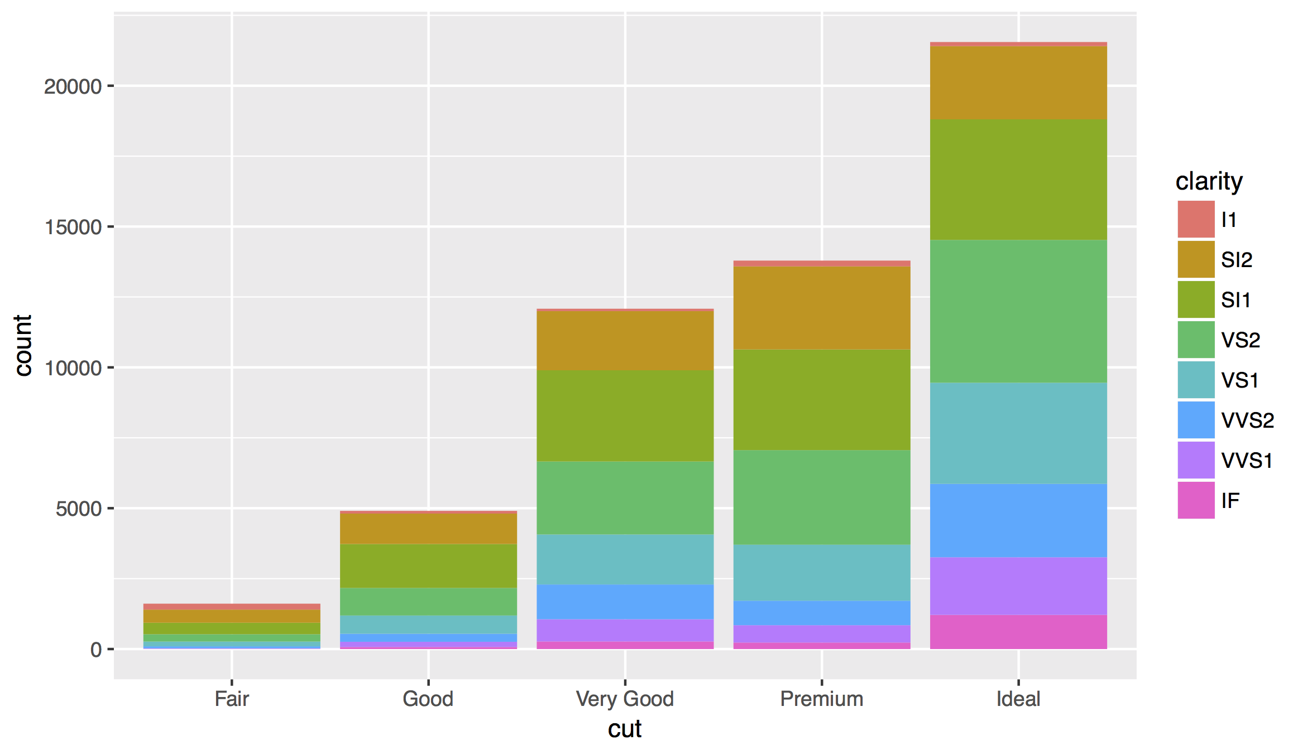

Slide 86
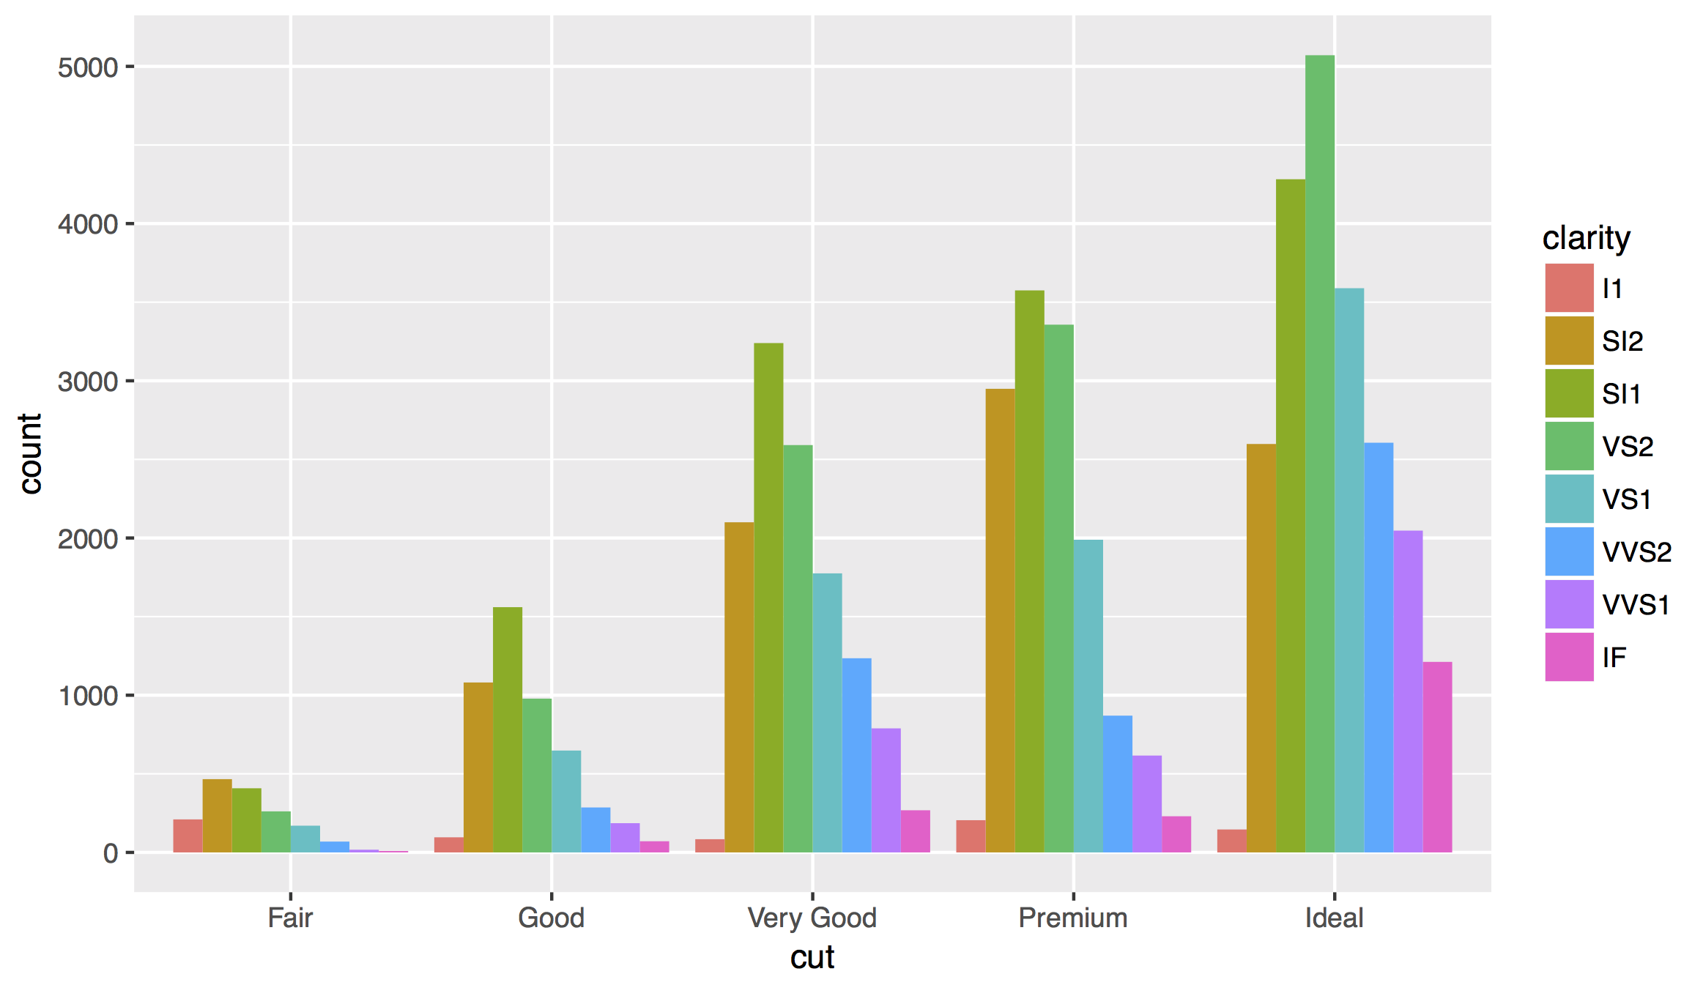
Position Adjustments
How overlapping objects are arranged

Slide 87
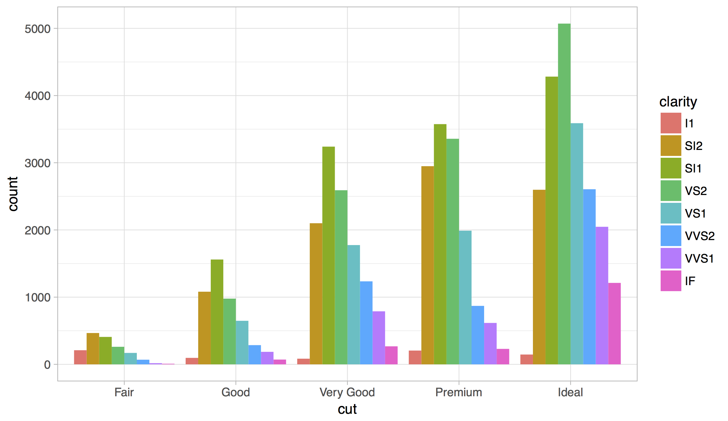
Themes
Visual appearance of non-data elements
+ theme_bw()

Slide 88
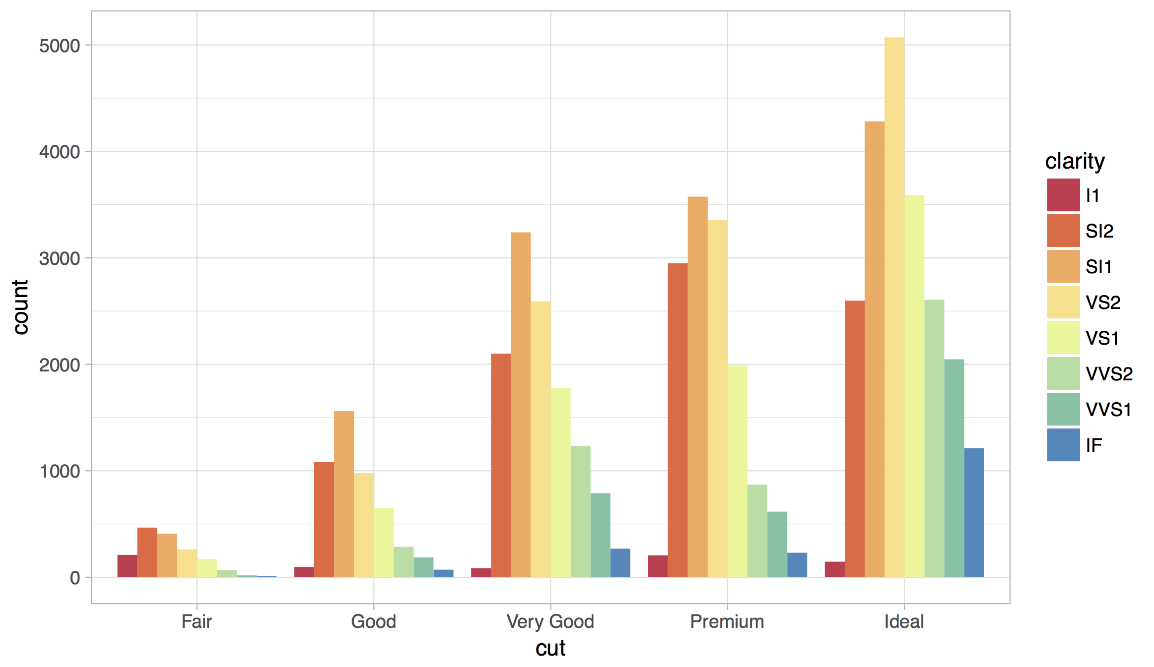
Scales
Customize color scales, other mappings

Slide 89
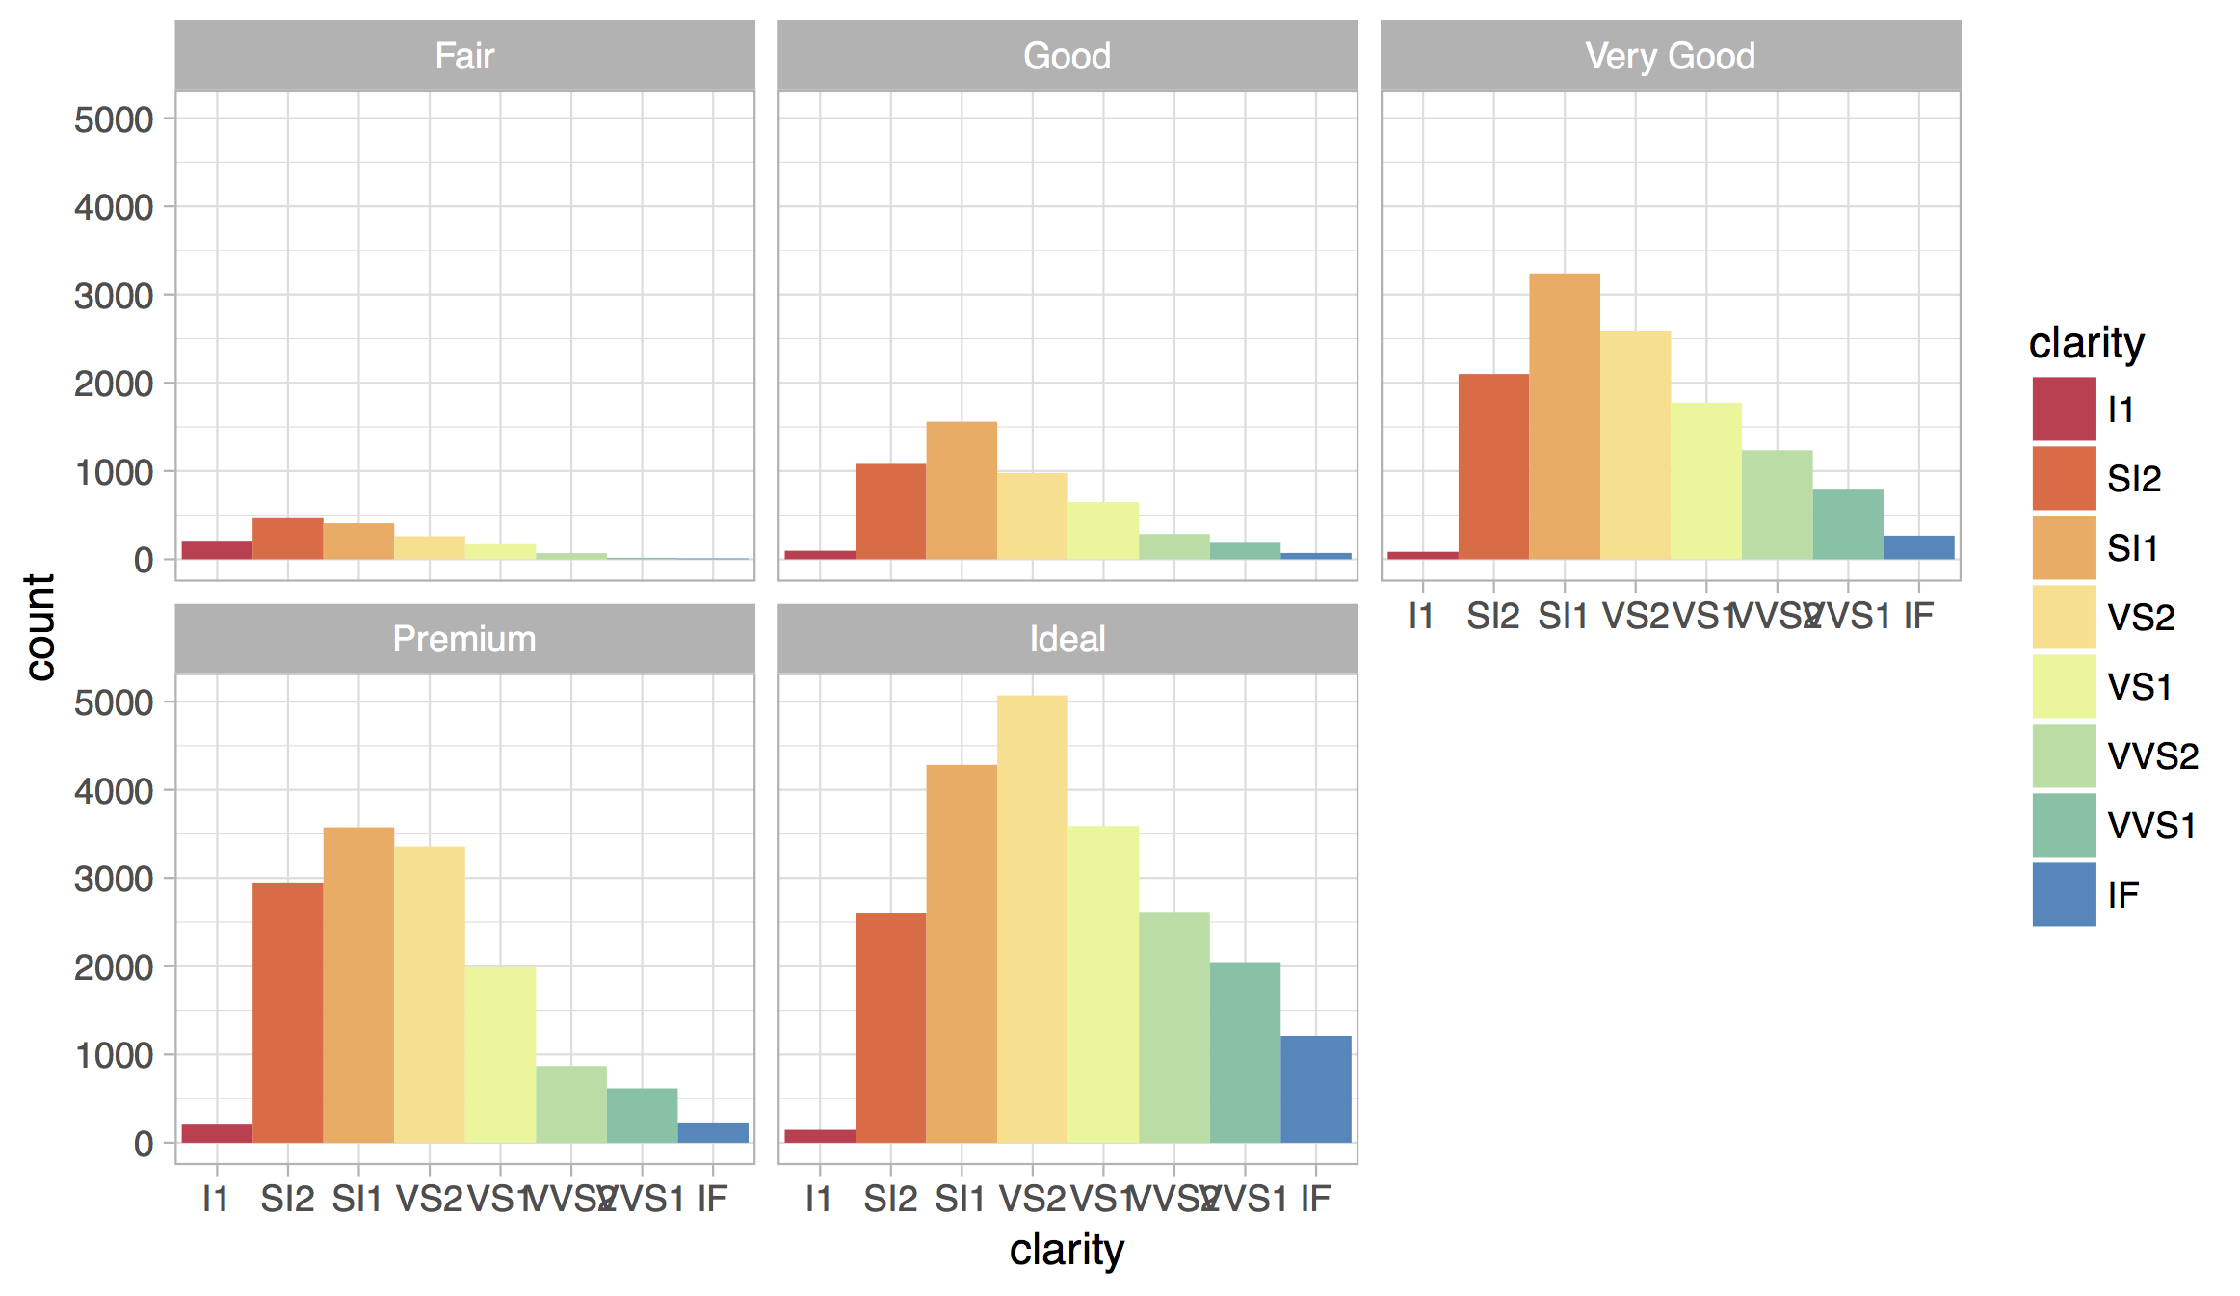
Facets
Subplots that display subsets of the data.

Slide 90
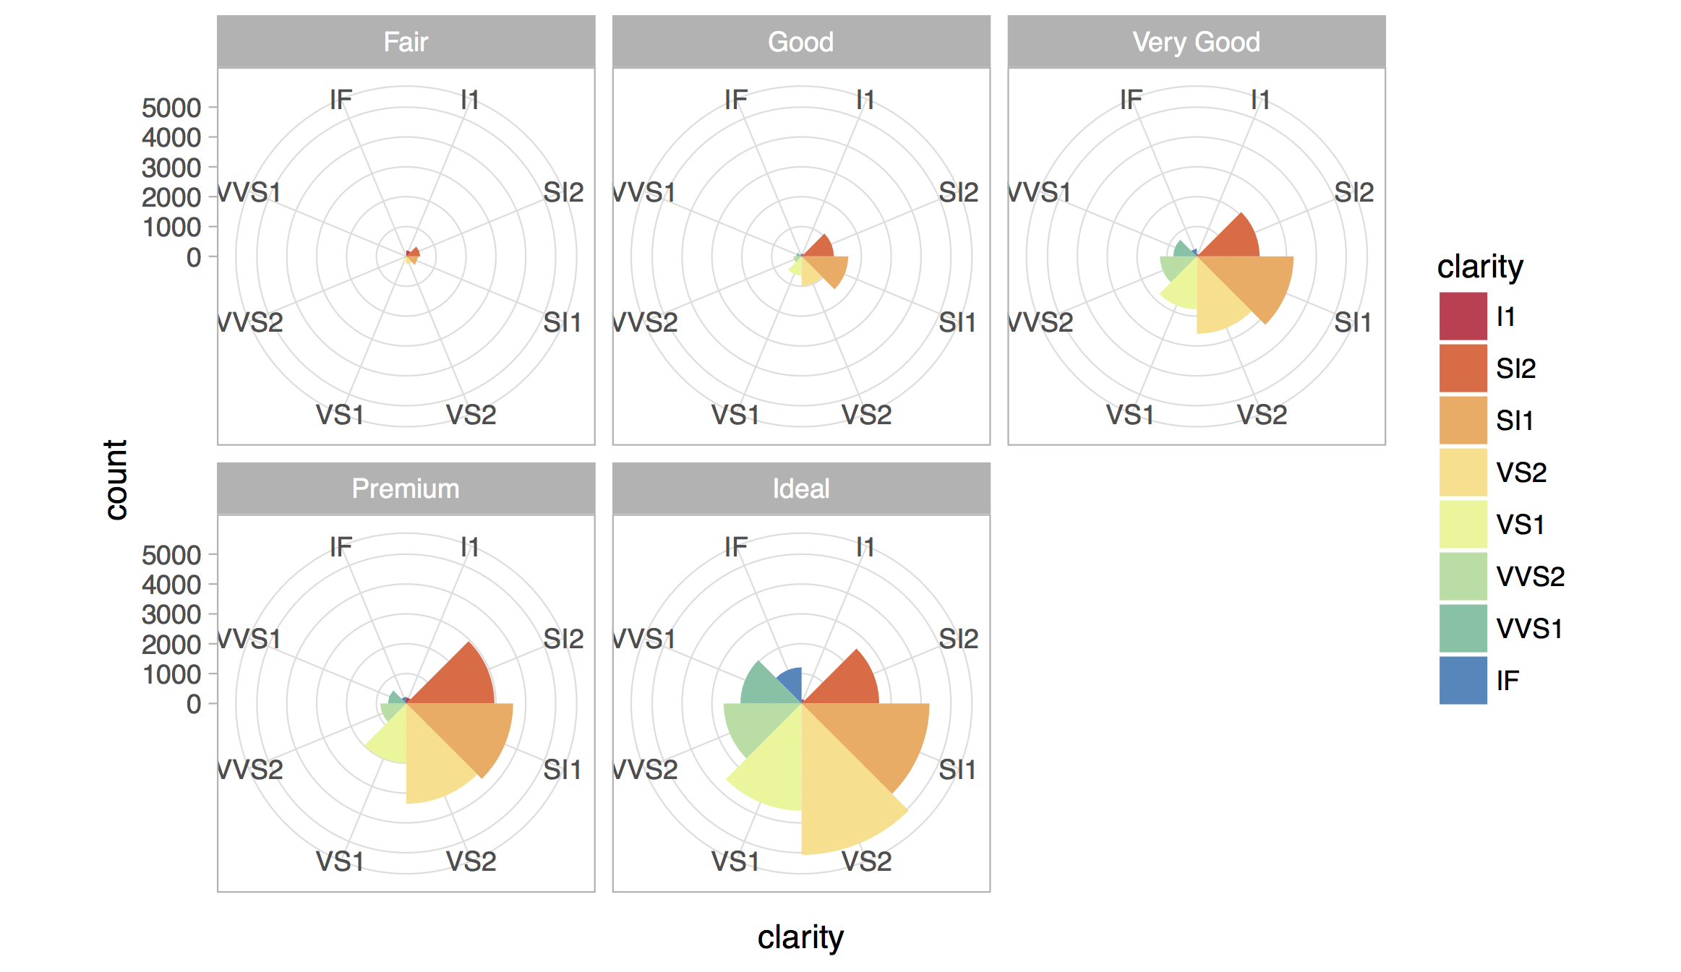
Coordinate systems

Slide 91
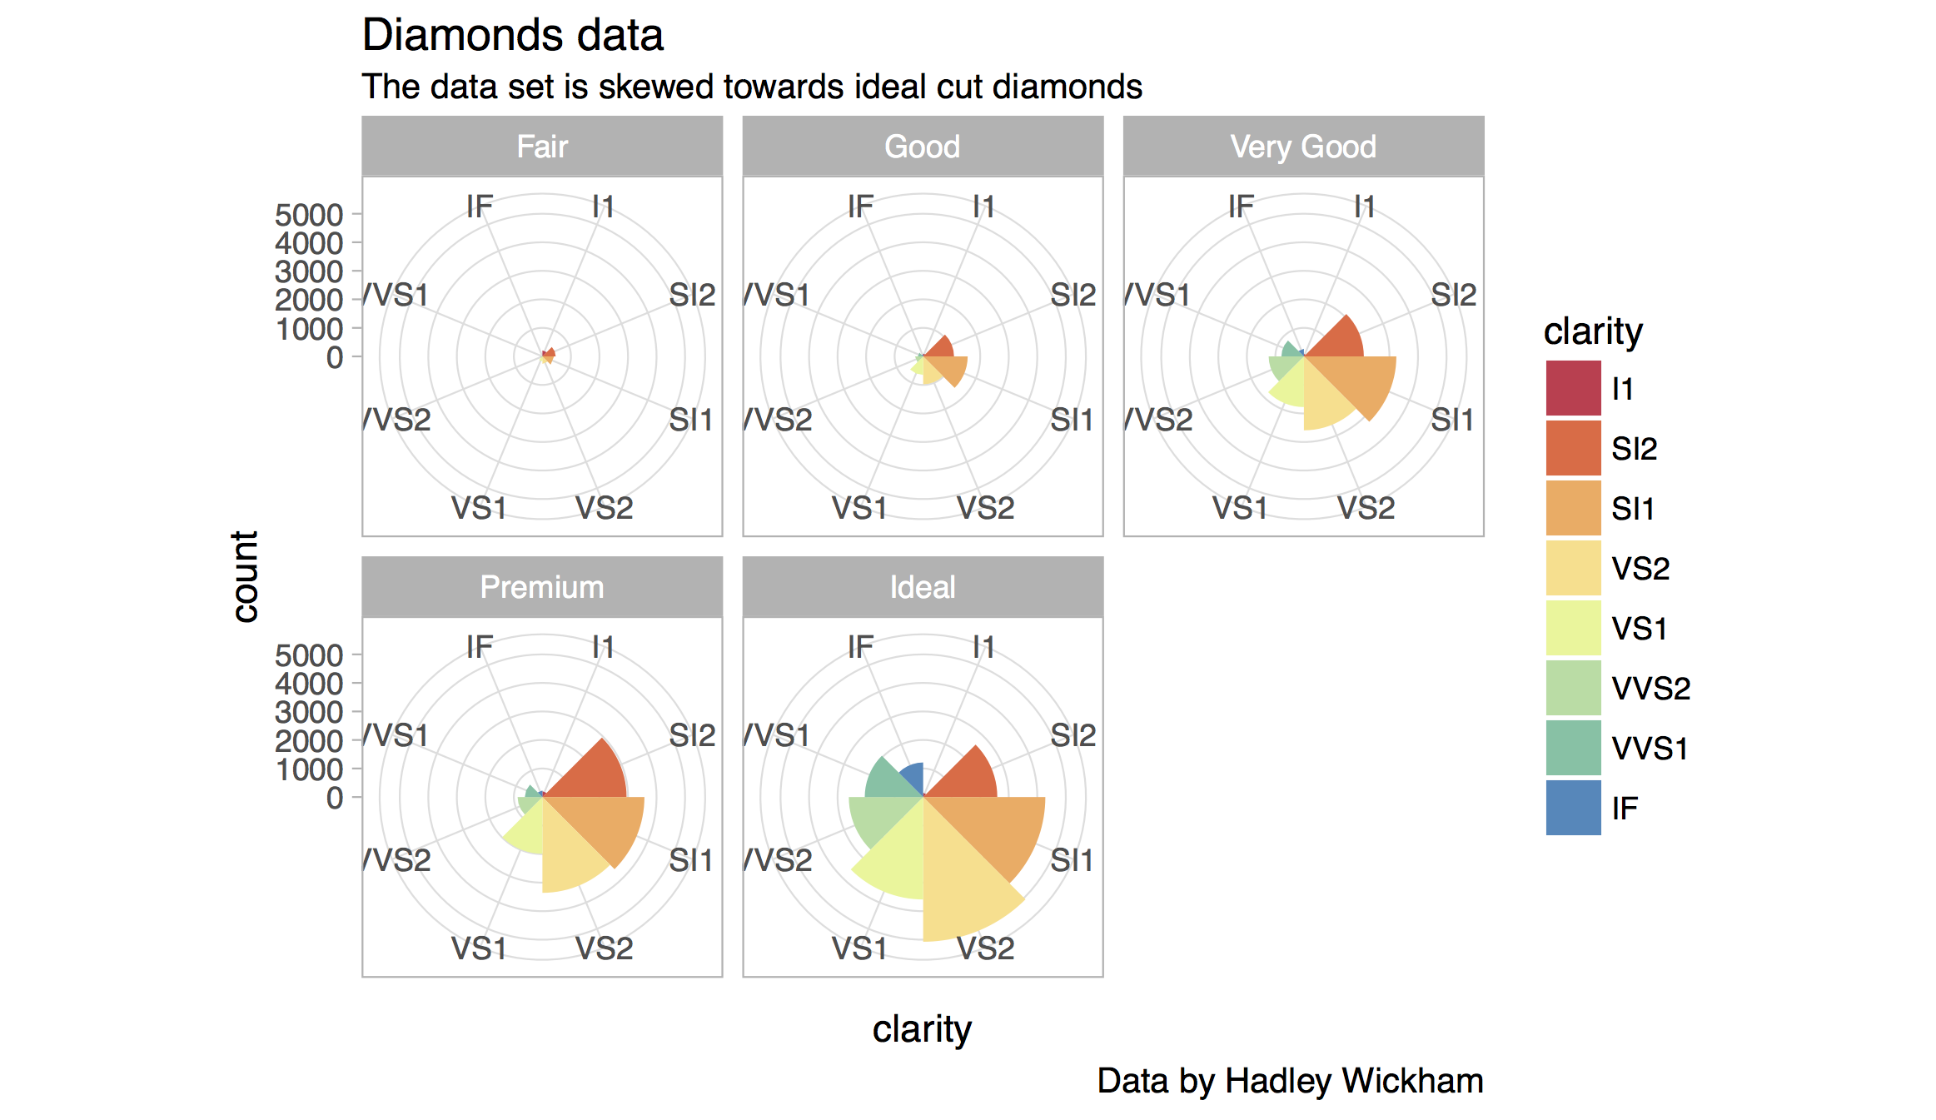
Titles and captions

Slide 92
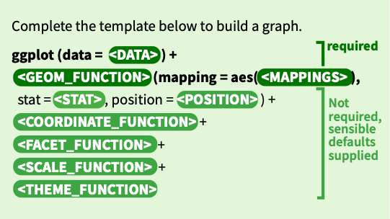
A ggplot2 template
Make any plot by filling in the parameters of this template

Slide 93
David B Sparks, http://bit.ly/hn54NW

Slide 94

David Kahle, https://dl.dropbox.com/u/24648660/ggmap%20useR%202012.pdf

Slide 95
James Cheshire, http://bit.ly/xqHhAs

Slide 96


r4ds.had.co.nz
The ultimate resource for all of today
Complete and free online

Slide 97

rstudio.cloud/learn/primers
Click Primers in the sidebar

Slide 98
Your Turn
Navigate up to the 03-Transform folder.
Open 03-Transform-Exercises.Rmd

Slide 99
Visualize Data with

